Slide 1
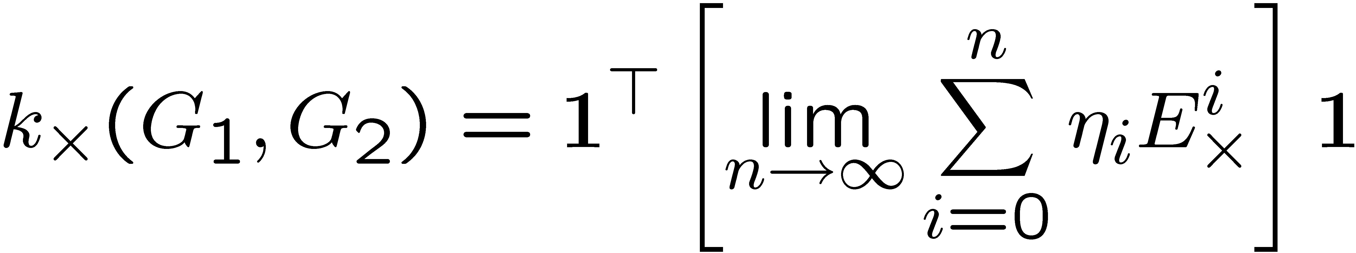
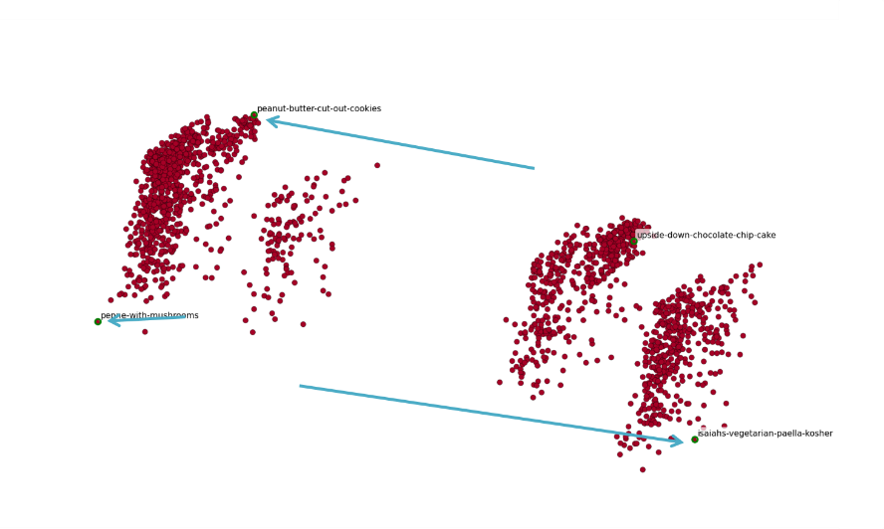
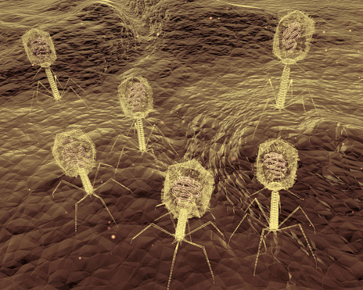
Dealing with Data: Machine Learning and Data Mining
Illustrations, Applications, and Research

Slide 2

about.us

Slide 3






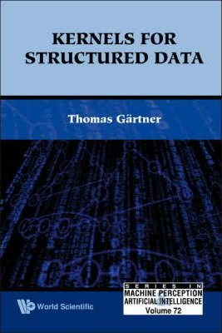





















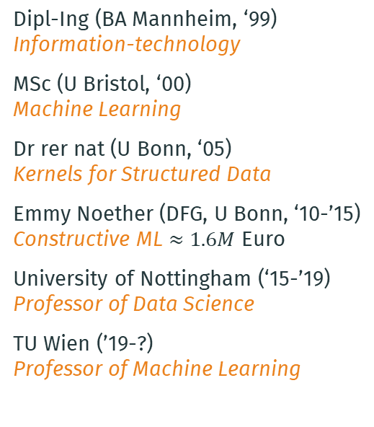
about.me
Dipl-Ing (BA Mannheim, ‘99) Information-technology
MSc (U Bristol, ‘00) Machine Learning
Dr rer nat (U Bonn, ‘05)
Kernels for Structured Data
Emmy Noether (DFG, U Bonn, ‘10-’15) Constructive ML $≈1.6M$ Euro
University of Nottingham (‘15-’19)
Professor of Data Science
TU Wien (’19-?)
Professor of Machine Learning
collaborations
Awards
‘00, ‘03, ‘05, ‘06, ’07, ’09, ‘15, ’16, ‘19
Workshop Co-Chair CML’13, ’15, ’16; MLG ’06
Area Chair/SPC
IJCAI ’19, ICLR ’21
NeurIPS ’23 - ’18, ’17, ’15
ECML/PKDD ’23 - ’19, ‘15, ‘14, ‘13
Editor for Machine Learning
Program Co-Chair ECML/PKDD’18
Journal-Track Co-Chair ECML/PKDD’16

Slide 4



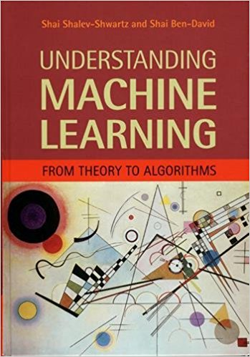
Recommended Books for Further Reading
Depending on the individual topic, one or the other chapter in these books might be useful to set the context.
free online version: Understanding Machine Learning

Slide 5


Slide 6

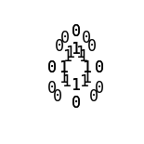

Slide 7


Slide 8
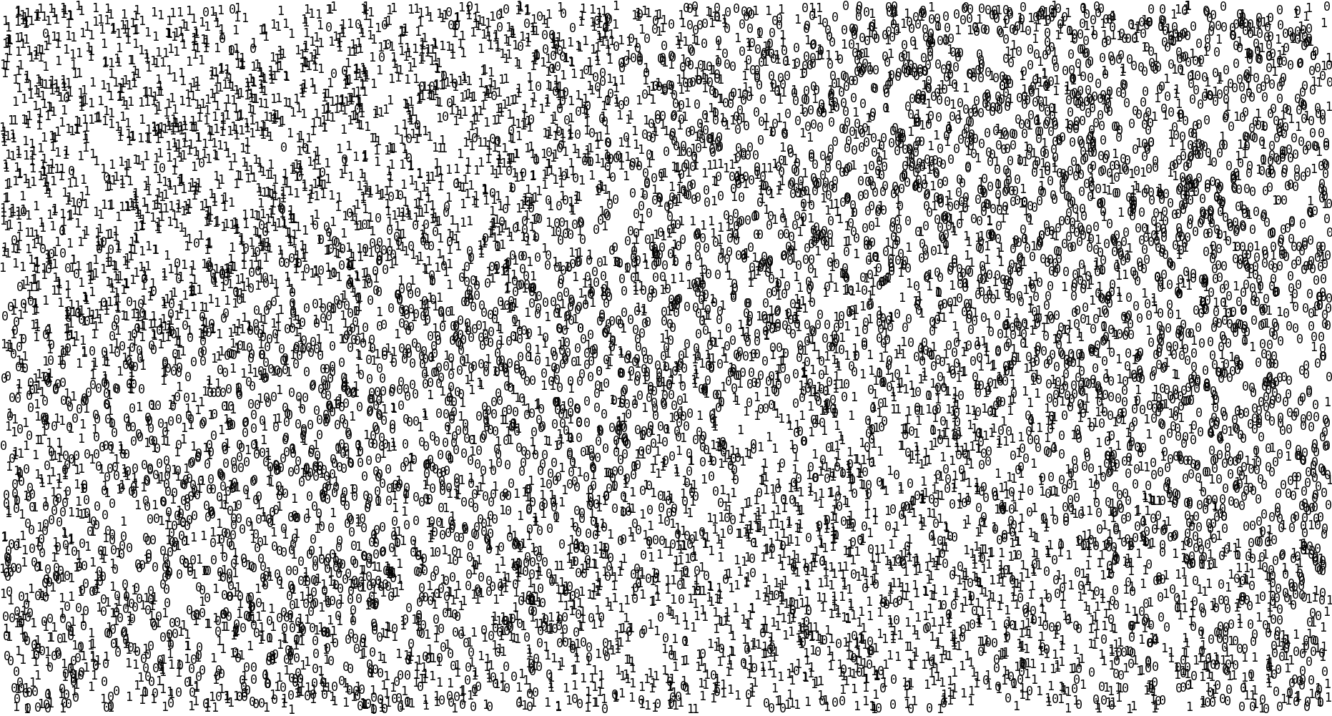

Slide 9


Slide 11
Data Mining

Slide 12
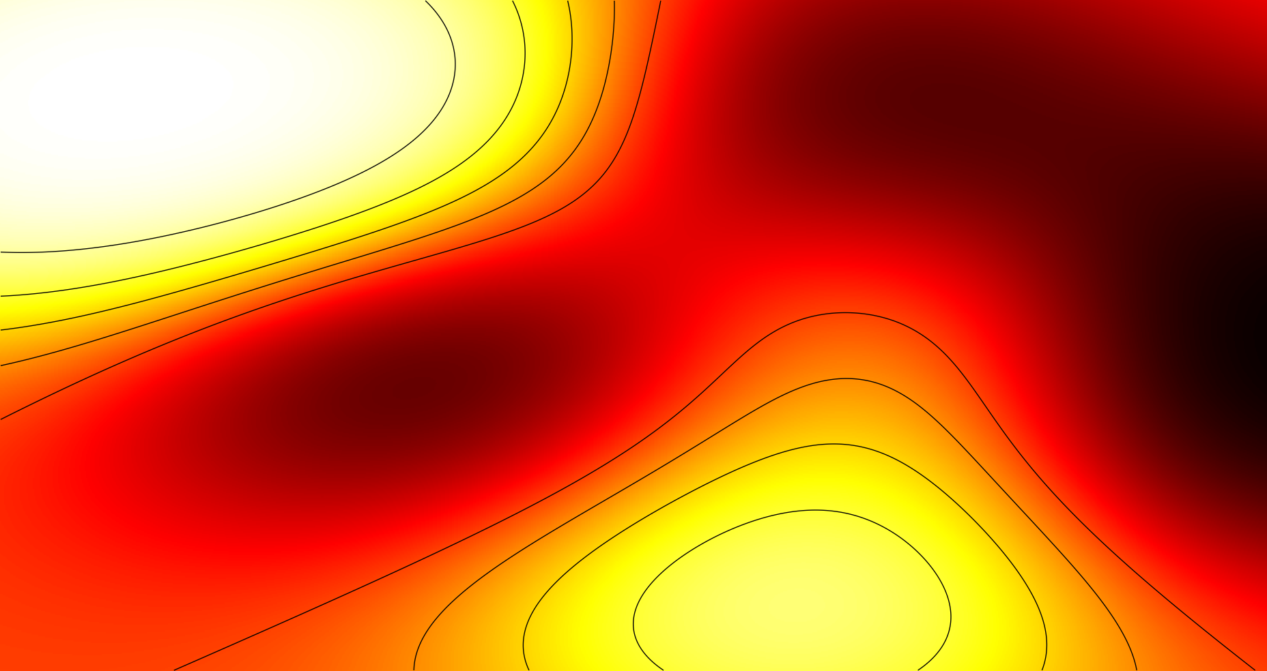
Machine Learning

Slide 13
Machine Learning

Slide 14
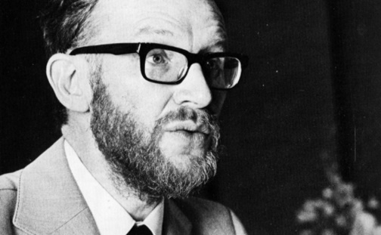
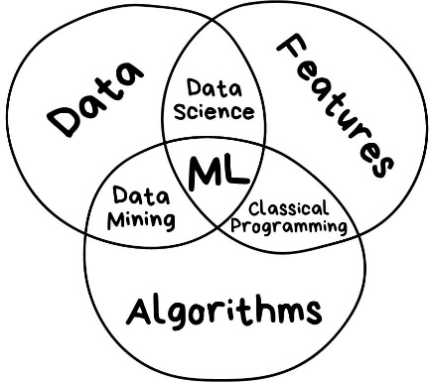
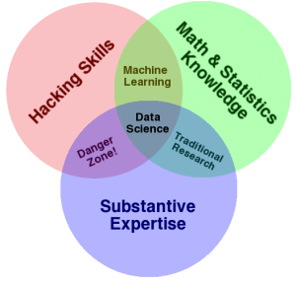


Datalogy, Data Science, …
Peter Naur (1974):
The science of dealing with data, once they have been established,
while the relation of the data to
what they represent is delegated
to other fields and sciences.
John W. Tukey:
The best thing about being a statistician is that you get to play in everyone's backyard
Don’t forget that statisticians are the free-est of all scientists — they
can work on anything. Take advantage.
(Vasily Zubarev, 2018)
(Drew Conway, 2010)
John Quackenbush (2014):
Every revolution in science—from Copernican heliocentric model to the rise of statistical and quantum mechanics, from Darwin’s theory of evolution and natural selection to the theory of the gene—has been driven by one and only one thing: access to data

Slide 15
Data Mining
Machine Learning
Artificial Intelligence
Pattern Recognition
Data
Data Science
Knowledge Discovery
Big Data
Deep Learning
Statistics
Data Analysis/Analytics
Information Processing
Computer Vision, Speech Recognition, Recommendation Systems, Computational Intelligence, Datalogy, Computational/Statistical/Algorithmic Learning Theory, Computational Statistics, Information Retrieval

Slide 16
“Hype or Hallelujah”?
(illustrations and examples of what ML can/cannot do)

Slide 17


Slide 18
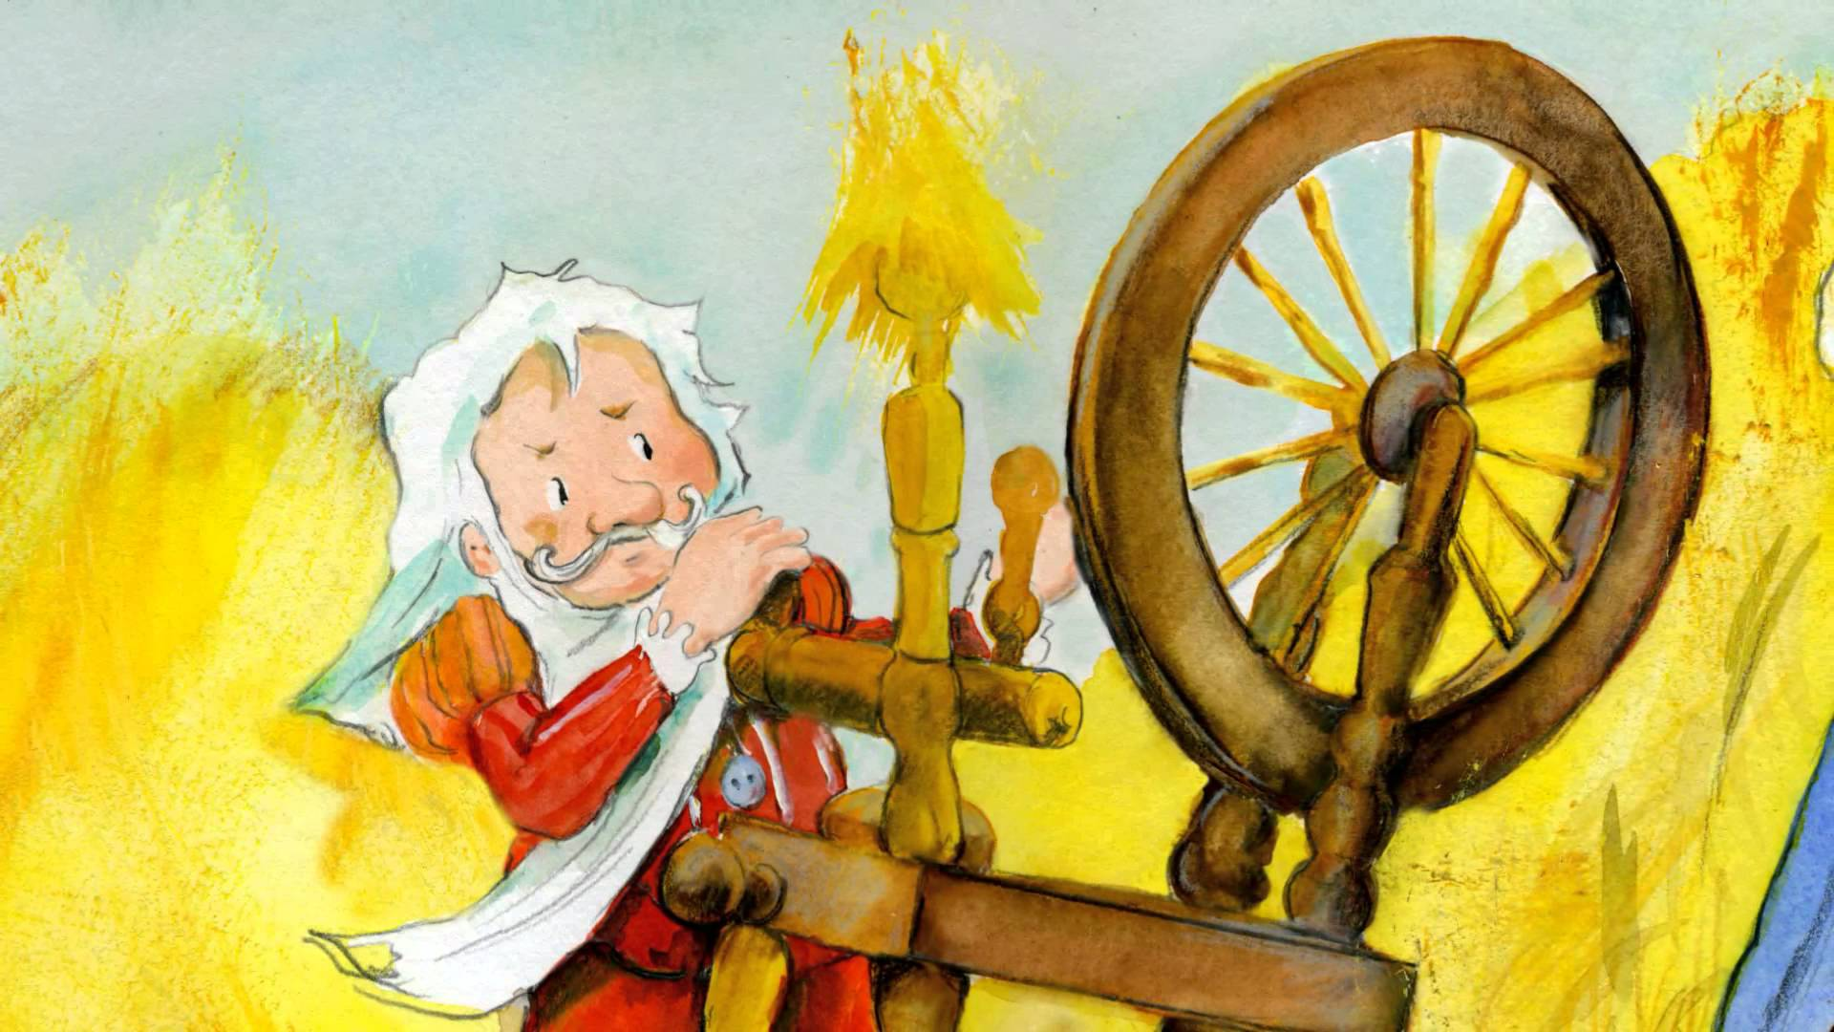

Slide 19
What is your data?

Slide 20
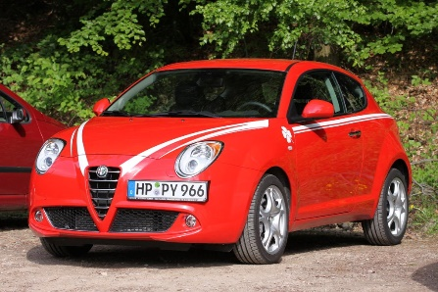
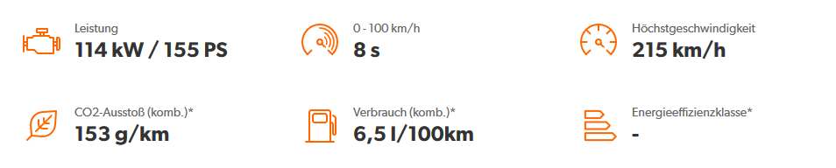
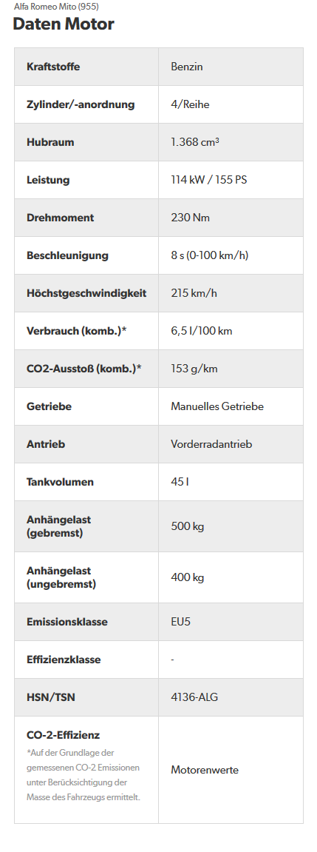
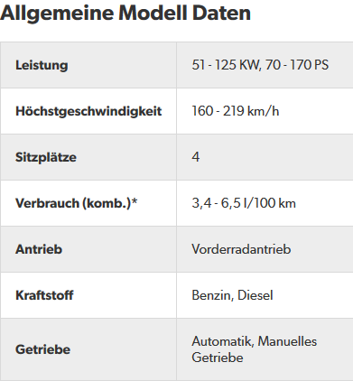
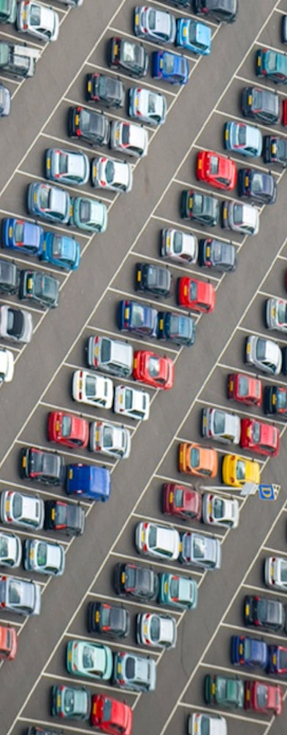
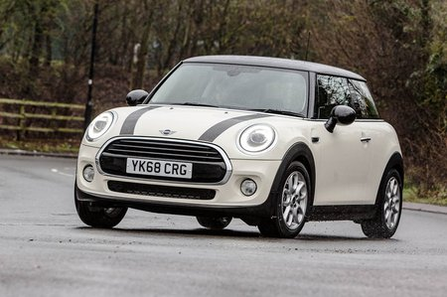
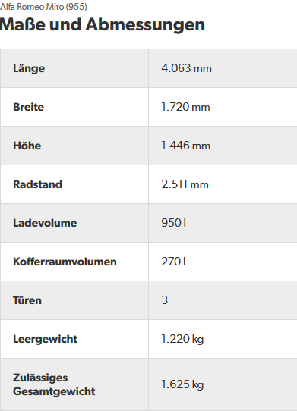
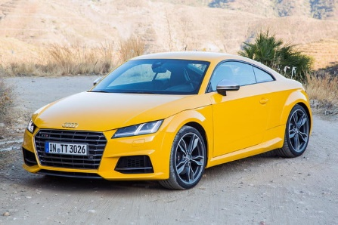
Data—Example: Cars

Slide 21
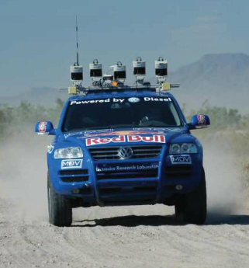
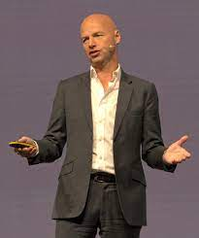


Machine Learning in the Media (i)

Slide 22





Machine Learning in the Media (ii)
[Center for Data Innovation]

Slide 23
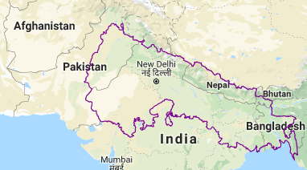
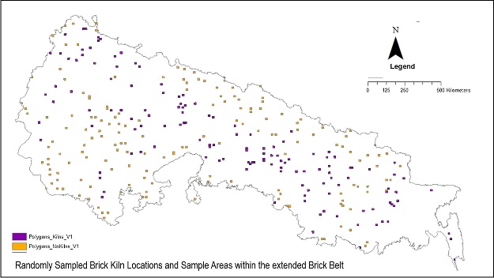
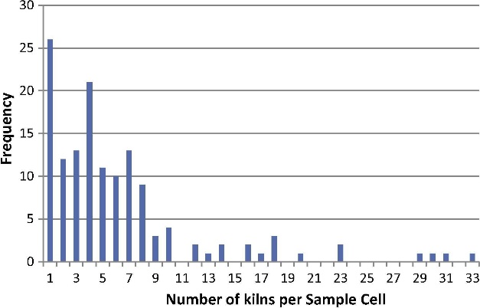
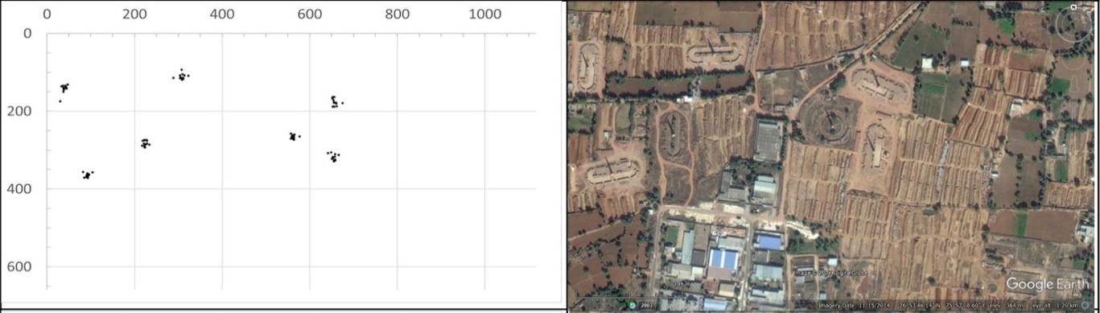
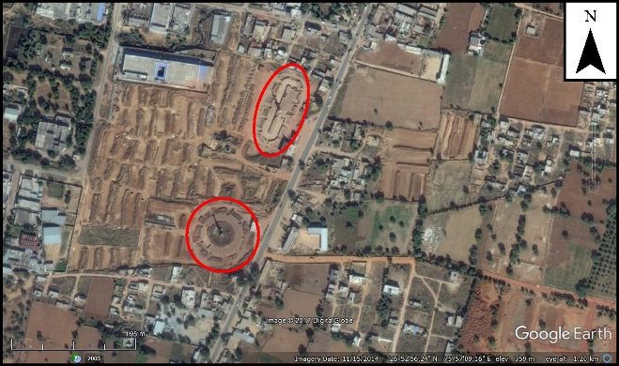
Active Search for Modern Slavery Sites (eg Brick Kilns @ Rights Lab)
Aim: use active search to minimise the amount of manual expert supervision needed

Slide 24

EVE
was released in […] 2003
a space-based, persistent world, massively multiplayer online role-playing game (MMORPG)
players of Eve Online can participate in a number of in-game professions and activities, including mining, piracy, manufacturing, trading, exploration, and combat
a total of 7,800 star systems that can be visited by players.
In February 2013, Eve Online reached over 500,000 subscribers
Eve Online is functionally a single-universe game.
(Wikipedia)
Virtual world hires real economist
(Reuters)

Slide 25
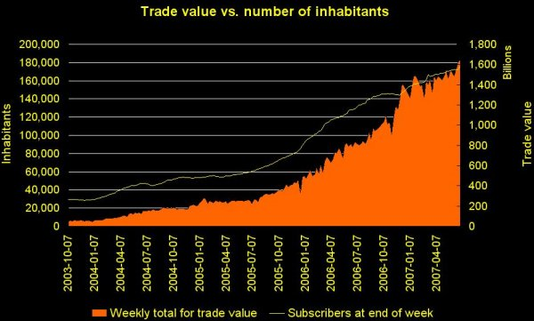
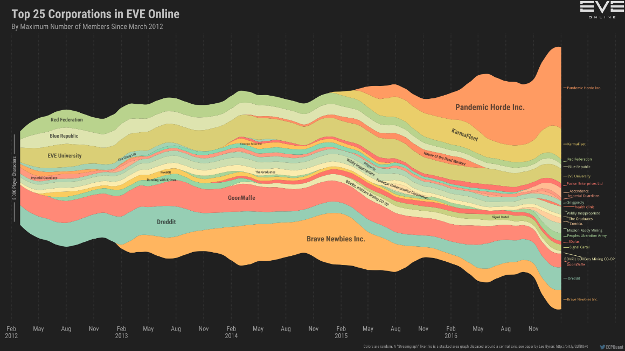
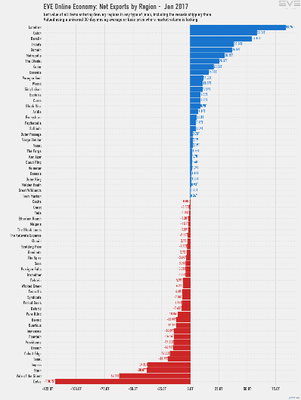
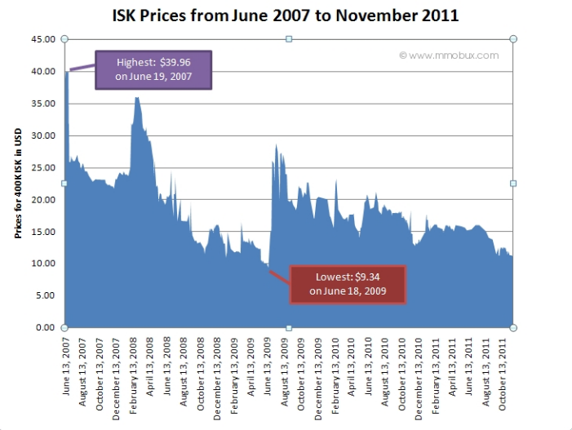

Slide 26
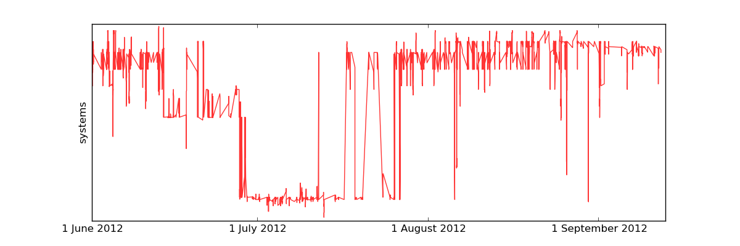
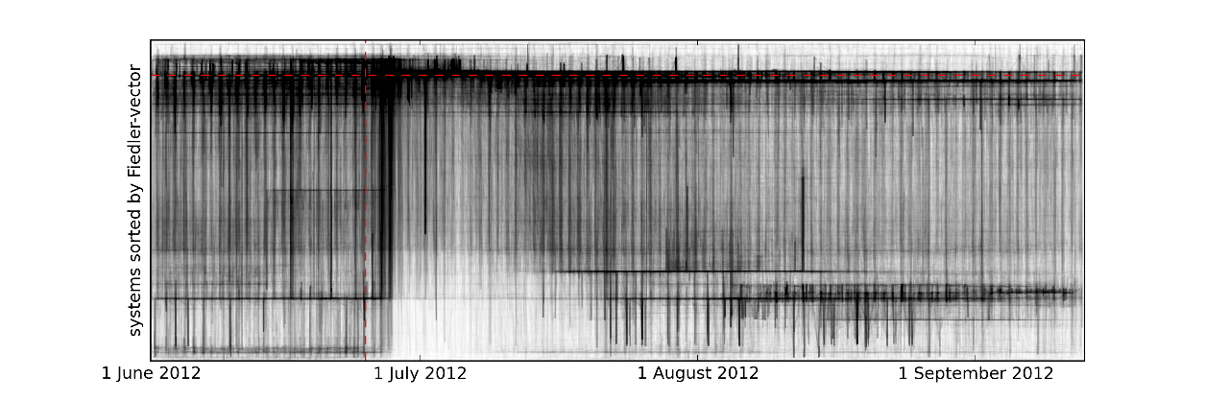
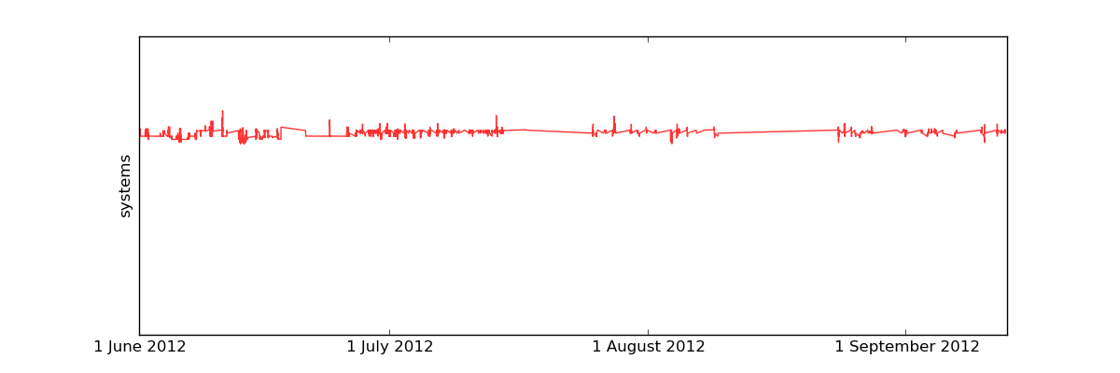
Load Balancing

Slide 27
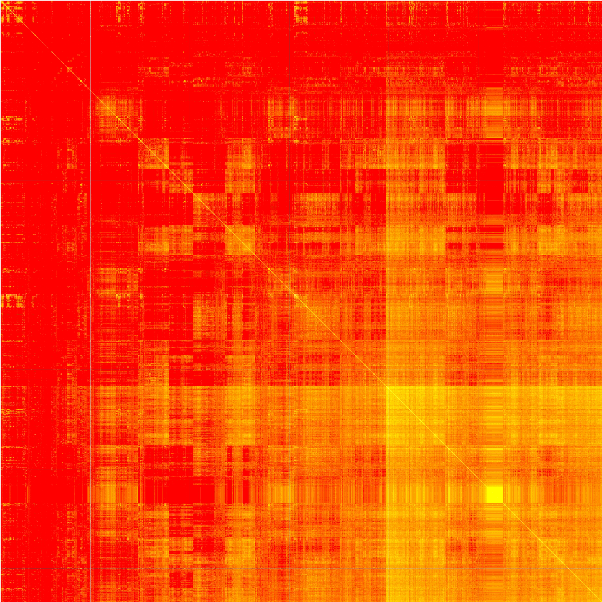
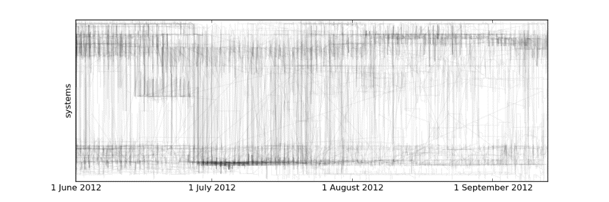
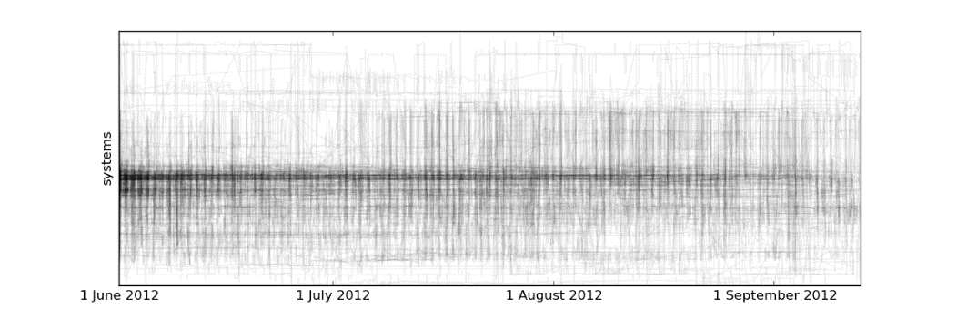
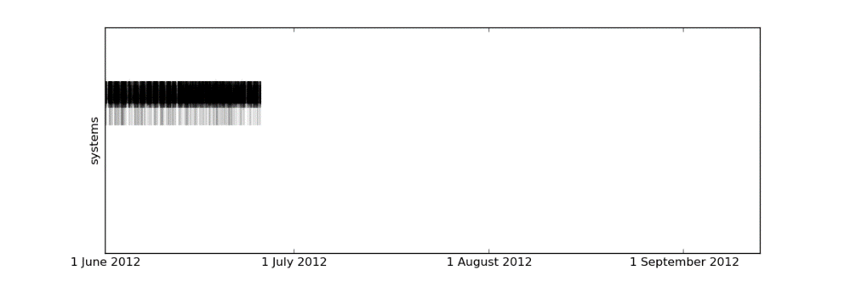
Group detection

Slide 28

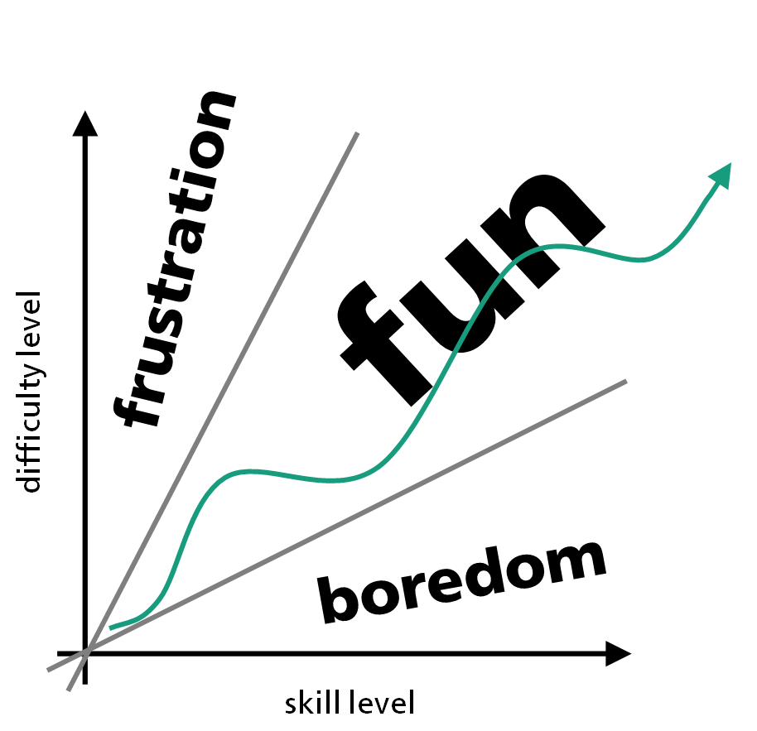
Automagic: Dynamical Difficulty Adjustment in Computer Games

Slide 29
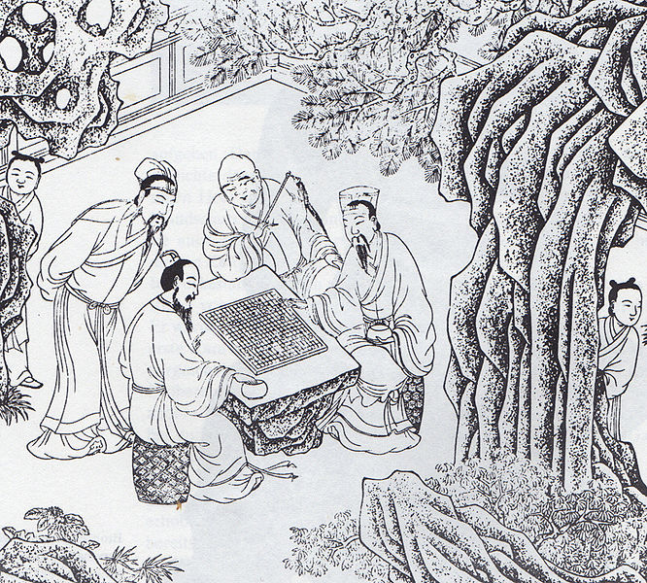
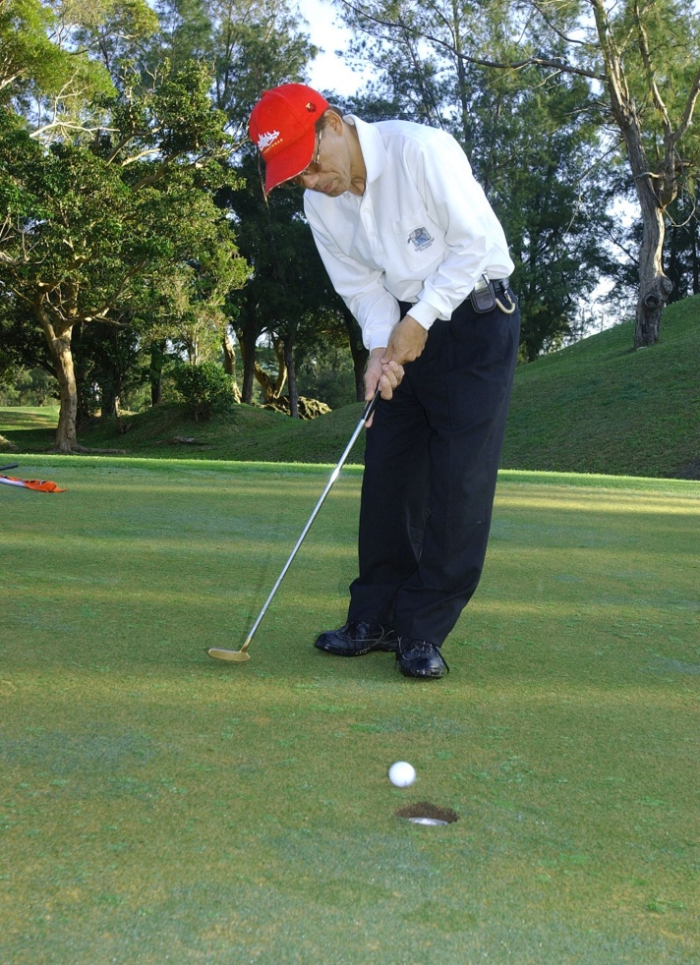
Traditional Difficulty Adjustment

Slide 30
Online Learning in Set Systems
given a universe and a family of subsets of the universe: 1. environment picks a `feasible’ set from the family 2. learner guesses a point 3. environment reveals a `separating’ set
make as few as possible infeasible queries (mistakes)
do not to rely on Euclidean geometry (convexity space)
do not make assumptions about the environment (adversary)
conceptually:
maintain belief over universe
multiplicatively update upon mistake
guess points that enforce large updates
algorithmically:
never compute belief explicitly / approximate guesses

Slide 31
Difficulty Modelling
easiest setting
most difficult setting

Slide 32
Static Difficulty Adjustment
easiest setting
suppose there was a fixed, “just right” setting
most difficult setting

Slide 33
Observations lead to deductions
x
too easy
x
x
x

Slide 34
Belief update in partially ordered sets
too easy

Slide 35
Pick vertex maximising the min(up, down)-belief
1.5
2.0
1.0
(1.0, 6.0)
(1.5, 5.5)
(2.0, 2.0)
1.5
3.5
1.0
1.0
0.5
(1.5, 5.0)
(3.5, 4.0)
(6.5, 1.0)
(2.5, 1.0)
(0.5, 8.5)
1.5
3.0
1.5
0.5
(1.5, 4.0)
(6.0, 3.0)
(7.0, 1.5)
(8.5, 0.5)
simple algorithm with a guaranteed bound on the number of mistakes
can (easily) be generalised to other structured spaces

Slide 36
Dynamic Difficulty Adjustment
1) game master predicts a difficulty setting
2) player plays one round of the game in this setting
3) game master observes whether the setting was
too easy, just right, or too difficult
this game is played on a partially ordered set reflecting the `is more difficult’-relation the goal of the game master is to predict `just right’-settings as often as possible
we can bound the number of mistakes in this setting

Slide 37
Use-Cases

Slide 38

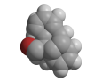
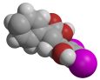
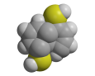
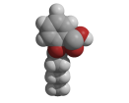
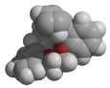
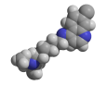
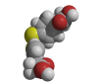

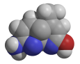



Drug discovery from a supervised learning point of view
-
+

Slide 39












Drug discovery with supervised learning

Slide 40
Cyclic Discovery Processes
design novel
candidate structures
huge, intensionally
specified design
space of structures
build a hypothesis of
the properties of all
structures from the
design space
to improve designs
design
analyse
realise designed
candidate structures
in their context
make
test
determine properties
of realised structures
in their context

Slide 41
Cyclic Discovery Processes
design novel
candidate structures
huge, intensionally
specified design
space of structures
build a hypothesis of
the properties of all
structures from the
design space
to improve designs
design
analyse
aim at general-purpose algorithms
inherently domain specific
realise designed
candidate structures
in their context
make
test
determine properties
of realised structures
in their context

Slide 42
Cyclic Discovery Processes – algorithmic challenges
design novel
candidate structures
huge, intensionally
specified design
space of structures
build a hypothesis of
the properties of all
structures from the
design space
to improve designs
design
analyse
cope with the cyclic nature
.
.
cope with the huge candidate space
.
aim at general-purpose algorithms
.
interface with domain experts
.
realise designed
candidate structures
in their context
make
test
determine properties
of realised structures
in their context
.

Slide 43



de novo Drug Design
pharm-space
analyse
design
Active

Slide 44
de novo Drug Design
pharm-space
it’s not about the pigeons anymore
analyse
design
it’s all about the peas (novel structures)
Active

Slide 45
de novo Drug Design
pharm-space
analyse
design
Active

Slide 46

de novo Drug Design
pharm-space
weighted maximum a posteriori
design
Active

Slide 47

de novo Drug Design
pharm-space
weighted maximum a posteriori
sample
Active

Slide 48





de novo Drug Design
pharm-space
weighted maximum a posteriori
sample
sample
Metropolis-Hastings
Active
until converged

Slide 49

Visual Data Exploration

Slide 50




pca
isomap (n=4)
isomap (n=8)
ica

Slide 51



Slide 52

ML/DM algorithms as Tools [ecmlpkdd’13, ecmlpkdd’14]
interactive algorithms response time & frame rate sampling & any time
domain-knowledge
natural vs technical parameters
concept-independent guarantees

Slide 53
decision trees

Slide 54














Assume we collected a data set … to predict the weather on our birthday, a week in advance…
/

Slide 55













Assume we collected a data set … to predict the weather on our birthday, a week in advance…
/
thu
2016
14,0
60
N
sat
2017
18,9
40
W
sun
2018
24,1
35
W

Slide 56


Decision Trees form a Hypothesis Class
consist of
inner nodes (splitting)
specified by selecting one attribute/feature
branch to their children depending on the feature value of an instance
outer nodes (decision)
specify the label that we predict for corresponding instances
can be used for
classification
regression
ranking
probability
can deal with
binary
categorical
numerical variables
missing
outliers

Slide 57


Decision Trees form a Hypothesis Class
consist of
inner nodes (splitting)
specified by selecting one attribute/feature
branch to their children depending on the feature value of an instance
outer nodes (decision)
specify the label that we predict for corresponding instances
can be used for
classification
regression
ranking
probability
can deal with
binary
categorical
numerical variables
missing
outliers
thu
2016
W

Slide 58
Decision Trees form a Hypothesis Class
consist of
inner nodes (splitting)
specified by selecting one attribute/feature
branch to their children depending on the feature value of an instance
outer nodes (decision)
specify the label that we predict for corresponding instances
can be used for
classification
regression
ranking
probability
can deal with
binary
categorical
numerical variables
missing
outliers
sat
2017
N

Slide 59





Decision Trees form a Hypothesis Class
2015
2016
2017
2018
…
What is a good or even optimal decision tree?
Can we always find a good or even an optimal one?
How long does it take to find a good or even an optimal one?

Slide 60
neural networks

Slide 61
Perceptron
$${ x}_{1}$$
$$f\left(x\right)=σ\left(\left\langle x,w\right\rangle \right)$$
$$f\left(x\right)=sign\left(\sum_{i=1}^{d}{x_{i}w_{i}}\right)$$
$$w$$
$${ x}_{2}$$
$$w_{1}$$
$$w_{2}$$
$${ x}_{3}$$
$$w_{3}$$
$$σ$$
$$w_{4}$$
$${ x}_{4}$$
$$w_{5}$$
$${ x}_{5}$$

Slide 62



Perceptron ($x^{(t)}∈ℝ^{d}, y_{t}∈\left\{−1,+1\right\}$ for $t=1, 2, …$)
traditionally used in online learning
expressivity
thresholded linear hypotheses (halfspaces)
simple Boolean functions (and, or, … )
learning theoretic bounds
data dimension based
radius-margin bound
downsides
linear hypotheses not very expressive
no xor/parity type data
fix
kernel perceptron
multi-layer perceptron
Rosenblatt, Frank (1957) The Perceptron--a perceiving and recognizing automaton. Report 85-460-1, Cornell Aeronautical Laboratory

Slide 63
Perceptron ($x^{(t)}∈ℝ^{d}, y_{t}∈\left\{−1,+1\right\}$ for $t=1, 2, …$)
traditionally used in online learning
expressivity
thresholded linear hypotheses (halfspaces)
simple Boolean functions (and, or, … )
learning theoretic bounds
data dimension based
radius-margin bound
downsides
linear hypotheses not very expressive
no xor/parity type data
fix
kernel perceptron
multi-layer perceptron
$f_{t}\left(x\right)=σ\left[\left\langle x^{(t)},w^{(t)}\right\rangle \right]$
$$w^{(t+1)}=w^{(t)}+\left\{\begin{matrix}0 & if f_{t}\left(x^{(t)}\right)=y_{t} \\ y_{t}x^{(t)} & otherwise\end{matrix}\right.$$
therefore, on mistake
$\left\langle x^{(t)},w^{(t+1)}\right\rangle =\left\langle x,w^{(t)}\right\rangle +y_{t}\left\|x^{(t)}\right\|$
recall
$σ$: sign function
$\left\langle ⋅,⋅\right\rangle$: inner product
Rosenblatt, Frank (1957) The Perceptron--a perceiving and recognizing automaton. Report 85-460-1, Cornell Aeronautical Laboratory

Slide 64

Convergence Proof
Radius/Margin assumption:
$$∃u∀t∈ℕ: \left\|x^{(t)}\right\|≤R, _y_{t}\left\langle u,x^{(t)}\right\rangle >γ$$
on misclassification:
$$σ\left(\left\langle w^{(t)},x^{(t)}\right\rangle \right)≠y_{t} w^{(t+1)}=w^{(t)}+y_{t}x^{(t)}$$
$$\left(\left\|u\right\|=1 \right)$$
Novikoff, Albert B.J. (1962). On convergence proofs on perceptrons. Symposium on the Mathematical Theory of Automata, 12, 615-622.

Slide 65

Convergence Proof
Radius/Margin assumption:
$$∃u∀t∈ℕ: \left\|x^{\left(t\right)}\right\|≤R, _y_{t}\left\langle u,x^{(t)}\right\rangle >γ$$
on misclassification:
$$σ\left(\left\langle w^{(t)},x^{(t)}\right\rangle \right)≠y_{t} w^{(t+1)}=w^{(t)}+y_{t}x^{(t)}$$
$$\left\langle u,w^{(t+1)}\right\rangle =\left\langle u,w^{(t)}\right\rangle +\left\langle u,x^{(t)}\right\rangle >\left\langle u,w^{(t)}\right\rangle +γ$$
$$\left\|u\right\|⋅ \left\|w^{(t+1)}\right\| ≥ \left\langle {u,w}^{\left(t+1\right)} \right\rangle >γm_{t}$$
Novikoff, Albert B.J. (1962). On convergence proofs on perceptrons. Symposium on the Mathematical Theory of Automata, 12, 615-622.

Slide 66

Convergence Proof
Radius/Margin assumption:
$$∃u∀t∈ℕ: \left\|x^{\left(t\right)}\right\|≤R, _y_{t}\left\langle u,x^{(t)}\right\rangle >γ$$
on misclassification:
$$σ\left(\left\langle w^{(t)},x^{(t)}\right\rangle \right)≠y_{t} w^{(t+1)}=w^{(t)}+y_{t}x^{(t)}$$
$\left\|u\right\|⋅ \left\|w^{\left(t+1\right)}\right\| ≥ \left\langle u,w^{\left(t+1\right)}\right\rangle =\left\langle u,w^{\left(t\right)}\right\rangle +y_{t}\left\langle u,x^{(t)}\right\rangle >\left\langle u,w^{(t)}\right\rangle +γ$ $>γm_{t}$
$${\left\|w^{(t+1)}\right\|}^{2}=\left\langle w^{(t+1)},w^{(t+1)}\right\rangle =\left\langle w^{(t)},w^{(t)}\right\rangle +2y_{t}\left\langle w^{\left(t\right)},x^{(t)}\right\rangle +\left\langle x^{(t)},x^{(t)}\right\rangle ≤{\left\|w^{\left(t\right)}\right\|}^{2}+R^{2}≤m_{t}R^{2}$$
$γ^{2}m_{t}^{2}<{\left\|w^{\left(t\right)}\right\|}^{2}≤m_{t}R^{2}$
$$m_{t}< \frac{R^{2}}{γ^{2}}$$
$$\left(\left\|u\right\|=1 \right)$$
Novikoff, Albert B.J. (1962). On convergence proofs on perceptrons. Symposium on the Mathematical Theory of Automata, 12, 615-622.

Slide 67


Update Illustration
$$u$$
$$w^{(t)}$$

Slide 68

Update Illustration
$$w^{(t+1)}$$
$$u$$
$$w^{(t)}$$

Slide 69
Proof Illustration
$$u$$
$$w^{(t)}$$

Slide 70
Proof Illustration
$$w^{(t+1)}$$
$$u$$
$$w^{(t)}$$

Slide 71
Proof Illustration
$$w^{(t+1)}$$
$$u$$
$$w^{(t)}$$

Slide 72

Proof Illustration
Pythagoras:
$${90°⇒a}^{2}+b^{2}=c^{2}$$
Novikoff:
$$<{90°⇒a}^{2}+b^{2}≥c^{2}$$
$${\left\|w^{\left(t\right)}\right\|}^{2}≤m_{t}R^{2}$$
$$w^{(t+1)}$$
$$u$$
$$w^{(t)}$$

Slide 73
Proof Illustration
$$w^{(t+1)}$$
$$u$$
$$w^{(t)}$$

Slide 74
Proof Illustration
$$w^{(t+1)}$$
$$u$$
$$w^{(t)}$$

Slide 75

Proof Illustration
$$w^{(t+1)}$$
$$u$$
$$w^{(t)}$$
Novikoff:
$$γ^{2}m_{t}^{2}<{\left\|w^{\left(t\right)}\right\|}^{2}$$

Slide 76


Proof Illustration
$$w^{(t+1)}$$
$$u$$
$$w^{(t)}$$
Novikoff:
$$γ^{2}m_{t}^{2}<{\left\|w^{\left(t\right)}\right\|}^{2}$$
$${\left\|w^{\left(t\right)}\right\|}^{2}≤m_{t}R^{2}$$
$γ^{2}m_{t}^{2}<{\left\|w^{\left(t\right)}\right\|}^{2}≤m_{t}R^{2}$
$$m_{t}< \frac{R^{2}}{γ^{2}}$$

Slide 77
Feedforward Networks: Multi-Layer Perceptron & Deep Neural Nets
$${ x}_{1}$$
$${ x}_{2}$$
$${ x}_{3}$$
$$σ$$
$${ x}_{4}$$
$${ x}_{5}$$

Slide 78
Feedforward Networks: Multi-Layer Perceptron & Deep Neural Nets
$${ x}_{1}$$
$$−w$$
$${ x}_{2}$$
$${ x}_{3}$$
$$σ$$
$${ x}_{4}$$
$${ x}_{5}$$

Slide 79
Feedforward Networks: Multi-Layer Perceptron & Deep Neural Nets
$${−w}_{2}$$
$${ x}_{1}$$
$${ x}_{2}$$
$$σ$$
$${ x}_{3}$$
$$σ$$
$${ x}_{4}$$
$$σ$$
$${−w}_{3}$$
$${ x}_{5}$$
$${−w}_{1}$$

Slide 80
Feedforward Networks: Multi-Layer Perceptron & Deep Neural Nets
$${ x}_{1}$$
$${−w}_{3}$$
$${−w}_{2}$$
$${ x}_{2}$$
$$σ$$
$${−w}_{1}$$
$${ x}_{3}$$
$$σ$$
$$σ$$
$${ x}_{4}$$
$$σ$$
$${ x}_{5}$$

Slide 81
Feedforward Networks: Multi-Layer Perceptron & Deep Neural Nets
$$σ$$
$$σ$$
$${ x}_{1}$$
$$σ$$
$$σ$$
$${ x}_{2}$$
$$σ$$
$$σ$$
$${ x}_{3}$$
$$σ$$
$$σ$$
$$σ$$
$${ x}_{4}$$
$$σ$$
$$σ$$
$${ x}_{5}$$
$$σ$$
$$σ$$
$$σ$$
$$σ$$

Slide 82
Feedforward Networks: Multi-Layer Perceptron & Deep Neural Nets
$$σ$$
$$σ$$
$${ x}_{1}$$
$$σ$$
$$σ$$
$${ x}_{2}$$
$$σ$$
$$σ$$
$${ x}_{3}$$
$$σ$$
$$σ$$
$$σ$$
$${ x}_{4}$$
$$σ$$
$$σ$$
$${ x}_{5}$$
$$σ$$
$$σ$$
$$σ$$
$$σ$$

Slide 83
Feedforward Networks: Multi-Layer Perceptron & Deep Neural Nets
$V_{1}$
$V_{D−1}$
$W_{1}$
$$V_{0}$$
$$σ$$
$$σ$$
$${ x}_{1}$$
$$σ$$
…
$$σ$$
$W_{D}$
$${ x}_{2}$$
$$σ$$
$$σ$$
$V_{D}$
$${ x}_{3}$$
$$σ$$
$$σ$$
$$σ$$
$$a_{D}$$
$$o_{D}$$
$${ x}_{4}$$
$$σ$$
$$σ$$
$${ x}_{5}$$
$$σ$$
$$σ$$
$$o_{0}$$
$$σ$$
$$σ$$
$$a_{1}$$
$$o_{1}$$
$$a_{D−1}$$
$$o_{D−1}$$
$$o_{0}=x$$
$$a_{d}=W_{d}o_{d−1}$$
$o_{d}=σ(a_{d})$

Slide 84
Feedforward Networks: Multi-Layer Perceptron & Deep Neural Nets
multiple, “stacked” “layers” of perceptrons
input layer
“hidden” feature-generating layer(s)
output layer
expressivity:
universal even with just one hidden layer
any Boolean function
downsides
expressivity requires exponential size
training becomes computationally hard
fix
heuristics work empirically very well
$V_{1}$
$V_{D−1}$
$W_{1}$
$$V_{0}$$
$$σ$$
$$σ$$
$${ x}_{1}$$
$$σ$$
…
$$σ$$
$W_{D}$
$${ x}_{2}$$
$$σ$$
$$σ$$
$V_{D}$
$${ x}_{3}$$
$$σ$$
$$σ$$
$$σ$$
$$a_{D}$$
$$o_{D}$$
$${ x}_{4}$$
$$σ$$
$$σ$$
$${ x}_{5}$$
$$σ$$
$$σ$$
$$o_{0}$$
$$σ$$
$$σ$$
$$a_{1}$$
$$o_{1}$$
$$a_{D−1}$$
$$o_{D−1}$$
$$o_{0}=x$$
$$a_{d}=W_{d}o_{d−1}$$
$o_{d}=σ(a_{d})$

Slide 85

Finding Minima: Waterflow

Slide 86
Gradient Descent (DG) vs Stochastic Gradient Descent (SGD)
source: Understanding Machine Learning by Shai Ben-David and Shai Shalev-Shwartz
GD: deterministic updates
in the direction of the gradient
SGD: random updates whose expectation is
in the direction of the gradient

Slide 87
Gradient Descent (DG) vs Stochastic Gradient Descent (SGD)
source: Understanding Machine Learning by Shai Ben-David and Shai Shalev-Shwartz
$$w^{\left(t+1\right)}←w^{\left(t\right)}−ηv_{t}$$
$$𝔼\left[v_{t} ∣ w^{\left(t\right)}\right]=∇f\left(w^{\left(t\right)}\right)$$
$$w^{\left(t+1\right)}←w^{\left(t\right)}−η∇f\left(w^{\left(t\right)}\right)$$
GD: deterministic updates
in the direction of the gradient
SGD: random updates whose expectation is
in the direction of the gradient

Slide 88
Backpropagation with Stochastic Gradient Descent (SGD)
$V_{1}$
$V_{D−1}$
$W_{1}$
for $t=1, …T$
sample $x,y$
$δ←$propagate$\left(x,y,w^{\left(t\right)},σ,σ^{′}\right)$
for all edges $(v_{d−1,j},v_{d,i})$
set $u_{d,j,i}←δ_{d,i}σ^{′}\left(a_{d,i}\right)o_{d−1,j}$
update $w^{(t+1)}←w^{(t)}−η_{t}(u+λw^{(t)})$
output best $w^{(t)}$ wrt validation set
$$V_{0}$$
$$σ$$
$$σ$$
$${ x}_{1}$$
$$σ$$
…
$$σ$$
$W_{D}$
$${ x}_{2}$$
$$σ$$
$$σ$$
$V_{D}$
$${ x}_{3}$$
$$σ$$
$$σ$$
$$σ$$
$$a_{D}$$
$$o_{D}$$
$${ x}_{4}$$
$$σ$$
$$σ$$
$${ x}_{5}$$
$$σ$$
$$σ$$
$$o_{0}$$
$$σ$$
$$σ$$
$$a_{1}$$
$$o_{1}$$
$$a_{D−1}$$
$$o_{D−1}$$
$$o_{0}←x$$
$$a_{d}←W_{d}o_{d−1}$$
$o_{d}←σ(a_{d})$
$$δ_{d}←W_{d}\left[δ_{d+1}⊗σ^{′}\left(a_{d+1}\right)\right]$$
$$δ_{D}←o_{D}−y$$

Slide 89


Slide 92


Slide 93


Slide 94


Slide 95


Slide 96
Support Vector Machines

Slide 97
The Magic that isn’t that Magical…
-
-
-
-
-
-
-
+
+
+
+
+
+

Slide 98
Classification by Linear Functions
-
-
-
-
-
-
-
+
+
+
+
+
+

Slide 99


Motivation: Support Vector Machines
-
-
-
-
-
-
-
+
+
+
+
+
+

Slide 100
Motivation: Support Vector Machines
-
-
-
-
-
-
-
+
+
+
+
+
+

Slide 101
Motivation: Support Vector Machines
-
-
-
-
-
-
-
+
+
+
+
+
+

Slide 102
Maximum Margin Hyperplane
-
-
+
+

Slide 103

Maximum Margin Hyperplane
-
-
+
+

Slide 104
Version Space Geometry of SVMs

Slide 105
Version Space Geometry of SVMs
x
SVM solution
„Bayes point“
x

Slide 106
Supervised Classification
?
+1
+1
training instances
with known labels
?
?
test instances with unknown labels
?
?
?
-1
?
?
+1
+1
+1
learning algorithm
-1
-1
model
prediction

Slide 107




Kernel Methods, e.g., Support Vector Machines
find linear separator in Hypothesis space (reproducing kernel Hilbert space)
maximally far from all labelled instances (robustness against measurement noise)
decision boundary in input space depends on kernel function
challenges for kernel design are validity (positive definite) and efficiency (polynomial time)
linear
sigmoid
Gaussian
polynomial

Slide 108
kernel methods – a way out?
k
data
zoo
algorithm
zoo

Slide 109
















Slide 110
Kernels for Basic Terms
valid!
efficient!
effective?
principles represent individuals by typed terms represent sets, multisets, etc. naturally
logic for learning (Lloyd, 2003) higher-order logic with polymorphic types the terms of the logic are the terms of the typed λ-calculus,
basic terms are essentially unambiguous closed terms of the logic basic abstractions are used to represent sets, multisets, etc

Slide 111


Structure Elucidation
type Spectrum = Frequency -> Multiplicity
type Frequency = Real with modifier Gaussian 0.6
data Multiplicity = s | d | t | q | 0 default 0
task
given the ¹³C NMR spectrum of Diterpenes,
predict the skeleton class it belongs to
data
1503 spectra classified into 23 skeleton types

Slide 112

Multi-Instance Kernels and a glimpse of Learning Theory
…
conformations
molecules
multi-instance concepts can be separated with kernels
for basic terms & the number of mistakes can be bounded.

Slide 113




Graph Kernels
common approach:
define kernel as some function of the common substructures (compare kernels for strings and trees)

Slide 114
Graph Kernels
common approach:
define kernel as some function of the common substructures (compare kernels for strings and trees)
computing the “all patterns” graph kernel is NP-hard; even for “all paths”, “all cycles”, or “all connected subgraphs” (with subgraph-isomorphism as the embedding).
computing complete graph kernels is at least as hard as deciding graph isomorphism

Slide 115
All-Walks Kernels
a
a
c
c
2
2
1
resort to non-complete graph kernels
consider as patterns the (multi-)set of
all labelled walks contained in a graph
while there can be infinitely many walks
we can measure the common ones efficiently
1
a
4
4
t
3
t
3
r
direct product graph
a
c
2,2
1,1
a
4,3
2,4
t

Slide 116

Cyclic Pattern Kernels
consider as patterns the set of all labelled cycles contained in a graph as well as all trees in the forrest of bridges
computing CPK is NP-hard but fixed-parameter tractable
log/log plot for HIV dataset #cycles over #molecules

Slide 117
</talk>
Ta!

Slide 118




Acknowledgements
collaborators:
Prof. Peter Flach, Prof. John W. Lloyd, Prof. Alex Smola, Prof. Stefan Wrobel, Prof. Tobias Scheffer,
Prof. Jürgen Bajorath, Prof. SVN Vishwanathan, Prof. Kristian Kersting, Prof. Stephane Canu,
Prof. Jan Ramon, Prof. Gilles Gasso, Prof. Kurt Driessens, Prof. Quoc V. Le, Prof. Jonathan D. Hirst
Simon J. F. Macdonald, Thomas Mcinally, Dr. Karina Zapien, Dr. Claudio Lucchese,
Dr. Hanna Geppert, Dr. Dagmar Stumpfe, Dr. Yasmin Altun, Dr. Gemma C. Garriga,
Dr. Adam Kowalczyk, Dr. Sandy Moens, Simon Burton, Steven A. Oatley,
group & alumni:
Prof. Ulf Brefeld, Prof. Roman Garnett, Prof. Dr. Nicolò Navarin, Dr. Mario Boley, Dr. Tamas Horvath,
Dr. Michael Kamp, Dr. Olana Missura, Dr. Daniel Paurat, Dr. Dino Oglic, Dr. Shankar Vembu, Bo Kang,
Jens Humrich, Laurentiu Ilici, Jiojian Wang, Katrin Ullrich, Alexe Haywood (UoN), Joeseph Redshaw (UoN),
Maximilian Thiessen (TU Wien), & we are hiring@TU Wien

Slide 119
appendix

Slide 120

Classic Example Application for Supervised Learning

Slide 121


Unsupervised Learning / k-means

Slide 122






Computer Vision using Machine Learning
image
classification
object
detection
semantic
segmentation
instance
segmentation
pose
estimation

Slide 123

Types of Machine Learning

Slide 124



Machine Learning Algorithm Zoo

Slide 125

Machine Learning Algorithm Zoo Guide

Slide 126



Machine Learning Process (CRISP-DM vs Microsoft Azure)

Slide 127
the state-of-the-art

Slide 128
Machine Learning Timeline
1763 Thomas Bayes
1805 Adrien-Marie Legendre (LSR)
1812 Pierre-Simon Laplace (Bayes’ Theorem)
1913 Andrey Markov (Markov Chains/MCMC)
1950 Alan Turing (test + GA)
1951 Marvin Minsky (NN:SNARC)
1951 checkers
1957 Frank Rosenblatt (perceptron)
1992 Backgammon, rivalling top human players
1967 nearest neighbour
1997 Chess, beating the world champion
1970 AD/Backpropagation
2016 Go, beating the world champion
1989 Chris Watkins (RL:QL)
1995 Tin Kam Ho (RF)
1995 Corinna Cortes and Vladimir Vapnik (SVM)

Slide 129



Machine Learning, a global trend
2012/14
2018/19

Slide 130








Machine Learning Tools

Slide 131







Machine Learning and Companies (Sponsoring, 2017)

Slide 132


Slide 133
overfitting

Slide 134

Notes:
https://www.theguardian.com/lifeandstyle/shortcuts/2013/dec/13/thirteen-superstitions-friday-the-13th-black-cat-ladder-magpie

Slide 135


Slide 139
Illustration
[xkcd, 2012]

Slide 140

Real-World Examples
“Borussia Dortmund has never lost a Champions League home game to a Spanish opponent when they have lost the previous Bundesliga away game by more than two goals, having scored at least once themselves.”

Slide 142

[Gordon Moore, 1965 ; Nate Silver, "The Signal and the Noise"]

Slide 144





[Economist, 2014; World nuclear association, 2018]

Slide 145


Slide 146
Is this really a problem in machine learning?

Slide 147
Is this really a problem in machine learning?

Slide 148
Is this really a problem in machine learning?
[Azulay & Weiss, 2019; Rosenfeld et al, 2018]

Slide 149


Slide 150




Classification and Regression Examples

Slide 151
Under-, “Perfect”-, and Over-fitting Examples
[Joglekar, 2018; Despois, 2018]

Slide 152


Risk Structure
0 training error
$$𝒳→𝒴$$
$$ℋ_{i}$$

Slide 153

Risk Structure
minimiser of training error
0 training error
$$t_{i}$$
$$𝒳→𝒴$$
$$ℋ_{i}$$

Slide 154



Risk Structure
minimiser of training error
0 training error
$$⋯⊆ℋ_{i−1}⊆ℋ_{i}⊆ℋ_{i+1}⊆⋯⊆𝒳→𝒴$$
$t_{i+1}$
$$t_{i}$$
$$𝒳→𝒴$$
$$ℋ_{i}$$
$$ℋ_{i+1}$$

Slide 155



Risk Structure
minimiser of training error
0 training error
$$⋯⊆ℋ_{i−1}⊆ℋ_{i}⊆ℋ_{i+1}⊆⋯⊆𝒳→𝒴$$
$t_{i+1}$
$$t_{i}$$
$$t_{i−1}$$
$$𝒳→𝒴$$
$$ℋ_{i−1}$$
$$ℋ_{i}$$
$$ℋ_{i+1}$$

Slide 156




Risk Structure
minimiser of training error
0 training error
$$⋯⊆ℋ_{i−1}⊆ℋ_{i}⊆ℋ_{i+1}⊆⋯⊆𝒳→𝒴$$
$t_{i+1}$
expected error
generalisation error
training error
$$t_{i}$$
$$t_{i−1}$$
x
$$𝒳→𝒴$$
x
$$ℋ_{i−1}$$
$$ℋ_{i}$$
$$ℋ_{i+1}$$
x
$$ℋ_{i−1}$$
$$ℋ_{i}$$
$$ℋ_{i+1}$$

Slide 157
Risk Structure
minimiser of training error
0 training error
$$⋯⊆ℋ_{i−1}⊆ℋ_{i}⊆ℋ_{i+1}⊆⋯⊆𝒳→𝒴$$
$t_{i+1}$
expected error
generalisation error
training error
$$t_{i}$$
$$t_{i−1}$$
$$𝒳→𝒴$$
$$ℋ_{i−1}$$
$$ℋ_{i}$$
$$ℋ_{i+1}$$
$$ℋ_{i−1}$$
$$ℋ_{i}$$
$$ℋ_{i+1}$$

Slide 158


Risk Structure
minimiser of training error
0 training error
$$⋯⊆ℋ_{i−1}⊆ℋ_{i}⊆ℋ_{i+1}⊆⋯⊆𝒳→𝒴$$
minimiser of expected error
expected error
generalisation error
training error
$$t_{i}$$
$$b$$
$$e_{i}$$
optimal predictor
$$𝒳→𝒴$$
$$ℋ_{i}$$
$$ℋ_{i−1}$$
$$ℋ_{i}$$
$$ℋ_{i+1}$$

Slide 159

Risk Structure
minimiser of training error
0 training error
$$⋯⊆ℋ_{i−1}⊆ℋ_{i}⊆ℋ_{i+1}⊆⋯⊆𝒳→𝒴$$
$t_{i+1}$
expected error
generalisation error
training error
$$t_{i}$$
$$b$$
$$t_{i−1}$$
optimal predictor
$$𝒳→𝒴$$
$$ℋ_{i−1}$$
$$ℋ_{i}$$
$$ℋ_{i+1}$$
$$ℋ_{i−1}$$
$$ℋ_{i}$$
$$ℋ_{i+1}$$

Slide 160
Risk Structure
minimiser of training error
0 training error
$$⋯⊆ℋ_{i−1}⊆ℋ_{i}⊆ℋ_{i+1}⊆⋯⊆𝒳→𝒴$$
$t_{i+1}$
expected error
generalisation error
training error
$$t_{i}$$
$$b$$
$$t_{i−1}$$
optimal predictor
$$𝒳→𝒴$$
$$ℋ_{i−1}$$
$$ℋ_{i}$$
$$ℋ_{i+1}$$
$$ℋ_{i−1}$$
$$ℋ_{i}$$
$$ℋ_{i+1}$$

Slide 161
Risk Structure
minimiser of training error
0 training error
$$⋯⊆ℋ_{i−1}⊆ℋ_{i}⊆ℋ_{i+1}⊆⋯⊆𝒳→𝒴$$
$t_{i+1}$
expected error
generalisation error
training error
$$t_{i}$$
$$b$$
$$t_{i−1}$$
optimal predictor
$$𝒳→𝒴$$
$$ℋ_{i−1}$$
$$ℋ_{i}$$
$$ℋ_{i+1}$$
$$ℋ_{i−1}$$
$$ℋ_{i}$$
$$ℋ_{i+1}$$

Slide 162
Risk Structure
minimiser of training error
0 training error
$$⋯⊆ℋ_{i−1}⊆ℋ_{i}⊆ℋ_{i+1}⊆⋯⊆𝒳→𝒴$$
$t_{i+1}$
expected error
generalisation error
training error
$$t_{i}$$
$$b$$
$$t_{i−1}$$
optimal predictor
$$𝒳→𝒴$$
$$ℋ_{i−1}$$
$$ℋ_{i}$$
$$ℋ_{i+1}$$
$$ℋ_{i−1}$$
$$ℋ_{i}$$
$$ℋ_{i+1}$$

Slide 163

Ways out: Regularisation and/or more data
Regularisation (often based on learning theoretic notions of model complexity/capacity)
decision tree pruning
early stopping
additive regularisation term
dropout
…
More data
$$⋯⊆ℋ_{i−1}⊆ℋ_{i}⊆ℋ_{i+1}⊆⋯⊆𝒳→𝒴$$
expected error
generalisation error
training error
$$ℋ_{i−1}$$
$$ℋ_{i}$$
$$ℋ_{i+1}$$

Slide 164

Next Up
Exercises
visually distinguishing types of fitting
practical work on data to notice the effect
Further Basics
validation
bias-variance decomposition
PAC learning
capacity measure
VC-dimension
Rademacher complexity
statistical learning & regularisation
ML / MAP / full Bayesian
Cutting-edge
when & why does interpolation work?
[Scott Fortmann-Roe]

Slide 165
decision trees

Slide 166
Assume we collected a data set … to predict the weather on our birthday, a week in advance…
/

Slide 167
Assume we collected a data set … to predict the weather on our birthday, a week in advance…
/
thu
2016
14,0
60
N
sat
2017
18,9
40
W
sun
2018
24,1
35
W

Slide 168
Decision Trees form a Hypothesis Class
consist of
inner nodes (splitting)
specified by selecting one attribute/feature
branch to their children depending on the feature value of an instance
outer nodes (decision)
specify the label that we predict for corresponding instances
can be used for
classification
regression
ranking
probability
can deal with
binary
categorical
numerical variables
missing
outliers

Slide 169
Decision Trees form a Hypothesis Class
consist of
inner nodes (splitting)
specified by selecting one attribute/feature
branch to their children depending on the feature value of an instance
outer nodes (decision)
specify the label that we predict for corresponding instances
can be used for
classification
regression
ranking
probability
can deal with
binary
categorical
numerical variables
missing
outliers
thu
2016
W

Slide 170
Decision Trees form a Hypothesis Class
consist of
inner nodes (splitting)
specified by selecting one attribute/feature
branch to their children depending on the feature value of an instance
outer nodes (decision)
specify the label that we predict for corresponding instances
can be used for
classification
regression
ranking
probability
can deal with
binary
categorical
numerical variables
missing
outliers
sat
2017
N

Slide 171
Decision Trees form a Hypothesis Class
2015
2016
2017
2018
…
What is a good or even optimal decision tree?
Can we always find a good or even an optimal one?
How long does it take to find a good or even an optimal one?

Slide 172
recall: Structural Risk
minimiser of
expected risk from $ℋ$
best
predictor
function
function
found from data
x
x
underfitting
function class too small,
no good function in there
x
overfitting
function class too large,
fitting the noise
$$𝒳→𝒴$$
$$ℋ$$
expected error
generalisation error
training error

Slide 173
History of Decision Trees
E.B. Hunt, J. Marin, P.J. Stone, Experiments in Induction, 1966
top-down induction of decision trees
to model human concept learning
A. Fielding. Binary segmentation: the automatic interaction detector and related techniques for exploring data structure, 1977.
for the analysis of survey data
J.R. Quinlan, Discovering rules by induction from large collections of examples, 1979.
information gain heuristic (ID3, later C4.5 J48)
L. Breiman, J.H. Friedman, R.A. Olshen, C.J. Stone, Classification and Regression Trees, 1984.
L. Hyafil and R. Rivest, Constructing optimal binary decision trees is NP-complete, 1976.
considered optimality of prediction time
T. Hancock, T. Jiang, M. Li, and J. Tromp, Lower bounds on learning decision lists and trees, 1996.
finding smallest decision tree is NP-hard

Slide 174
Simple&Generic Top-Down Decision Trees Induction Algorithm
grow_tree(D, F):
if stopping_criterion_satisfied(D):
return new_decision_node(D)
f <- select_feature_for_splitting(D, F)
T <- new_splitting_node()
for each value v of f:
T.add( grow_tree(D[f==v], F\f)
return T

Slide 175
Simple&Generic Top-Down Decision Trees Induction Algorithm
grow_tree(D, F):
if stopping_criterion_satisfied(D):
return new_decision_node(D)
f <- select_feature_for_splitting(D, F)
T <- new_splitting_node()
for each value v of f:
T.add( grow_tree(D[f==v], F\f)
return T
stopping_criterion_satisfied
checks if the tree should be grown further
decision_node
analyses what prediction should be made given the remaining data
new_splitting_node
creates a new inner node
add
grows a child of the current node

Slide 176
Simple&Generic Top-Down Decision Trees Induction Algorithm
grow_tree(D, F):
if stopping_criterion_satisfied(D):
return new_decision_node(D)
f <- select_feature_for_splitting(D, F)
T <- new_splitting_node()
for each value v of f:
T.add( grow_tree(D[f==v], F\f)
return T
stopping_criterion_satisfied
checks if the tree should be grown further
decision_node
analyses what prediction should be made given the remaining data
select_feature_for_splitting
decide which feature to break the dataset down by next
new_splitting_node
creates a new inner node
add
grows a child of the current node

Slide 177
Simple&Generic Top-Down Decision Trees Induction Algorithm
grow_tree(D, F):
if stopping_criterion_satisfied(D):
return new_decision_node(D)
f <- select_feature_for_splitting(D, F)
T <- new_splitting_node()
for each value v of f:
T.add( grow_tree(D[f==v], F\f)
return T
stopping_criterion_satisfied
checks if the tree should be grown further
decision_node
analyses what prediction should be made given the remaining data
select_feature_for_splitting
decide which feature to break the dataset down by next
new_splitting_node
creates a new inner node
add
grows a child of the current node

Slide 178
Simple&Generic Top-Down Decision Trees Induction Algorithm
grow_tree(D, F):
if stopping_criterion_satisfied(D):
return new_decision_node(D)
f <- select_feature_for_splitting(D, F)
T <- new_splitting_node()
for each value v of f:
T.add( grow_tree(D[f==v], F\f)
return T
stopping_criterion_satisfied
checks if the tree should be grown further
decision_node
analyses what prediction should be made given the remaining data
select_feature_for_splitting
decide which feature to break the dataset down by next
new_splitting_node
creates a new inner node
add
grows a child of the current node

Slide 179

Deep Learning

Slide 180



Feature Generation for Neural Networks

Slide 181
what we do

Slide 182

Interactive Machine Learning
@Technische Universität Wien, 9. 2. 2019

Slide 183

Dynamic Difficulty Adjustment [nips’11, cig‘11]
1) game master predicts a difficulty setting
2) player plays one round of the game in this setting
3) game master observes whether the setting was
too easy, just right, or too difficult
this game is played on a partially ordered set reflecting the `is more difficult’-relation the goal of the game master is to predict `just right’-settings as often as possible
we can bound the number of mistakes in this setting

Slide 184

de novo Drug Design
pharm-space
it’s not so much about the
pigeons (models) anymore
analyse
design
it’s all about the peas
(novel structures)
Active

Slide 185
Cyclic Discovery Processes – algorithmic challenges
design novel
candidate structures
huge, intensionally
specified design
space of structures
build a hypothesis of
the properties of all
structures from the
design space
to improve designs
design
analyse
cope with the cyclic nature
.
.
cope with the huge candidate space
.
aim at general-purpose algorithms
.
interface with domain experts
.
realise designed
candidate structures
in their context
make
test
determine properties
of realised structures
in their context
.

Slide 186
Kernel Methods, e.g., Support Vector Machines (SVM)
find linear separator in Hypothesis space (reproducing kernel Hilbert space)
with small norm (-> maximally far from all labelled instances, robustness against measurement noise)
decision boundary in input space depends on kernel function
challenges for kernel design are
validity (positive definiteness),
efficiency (polynomial time), and
effectiveness (good generalisation possible)
linear
sigmoid
Gaussian
polynomial

Slide 187



Kernels for Structured Data
Kernels for Basic Terms [icml’02, mlj‘04]
idea: data as terms in typped higher-order logic; type definition gives kernel % modifiers
theoretical results:
generally valid (psd) & efficient
effective for problem classes like MIL
Graph Kernels [colt’03,kdd‘04] idea: define kernel as some function of the common subgraphs (cf strings, trees, …)
but computing graph kernels is hard
for efficient computation consider
particular graphs-classes
different embedding operators, e.g., homomorphism
Structured Prediction [mlj’09, uai’09]
previous approaches turn out to be computationally hard for graphs
instead
$$\sum_{s∈S}{\left\langle φ\left(x,s\right), h\right\rangle } and \sum_{s∈S}{{\left\langle φ\left(x,s\right), h\right\rangle }^{2}}$$
can often be computed efficiently and
$$\sum_{s∈S}{exp\left(\left\langle φ\left(x,s\right), h\right\rangle \right)}$$
can often be approximated efficiently

Slide 188


de novo Drug Design [aaai’17]
weighted maximum a posteriori
sample
Active

Slide 189
de novo Drug Design [aaai’17]
pharm-space
weighted maximum a posteriori
sample
sample
Metropolis-Hastings
Active
until converged

Slide 190




Designing Drugs: Simulations [aaai’17] & Idiopathic Pulmonary Fibrosis [mi’18]
non-Hamiltonian graphs
greedy (baseline)
discovered 19 out of the 24 active
compounds which are known to be
active from previous biological assays!
active search

Slide 191


Speeding up machine learning
use the structure of the data to speed up optimisation [nips’06]
low-dimensional embeddings:
Boost the low-dimensional representation for shift-invariant kernels [nips’16]
Prove the effectiveness of k-means++ (sampling) for Nyström landmarks [icml’17]
Learning with non-positive definite kernels (Kreĭn spaces [icml’18]) [icml’19?]
a logarithmic number of features is often sufficient(!)
parallelise:
Guaranteed same performance as a non-parallel base-learning algorithm in polylogarithmic time using more data and many computational cores [nips’17] (cf Nick’s Class for decision problems)

Slide 192





Moore’s Law

Slide 193











ML for Computational Systems Chemistry / Mass Spectroscopy
under submission

Slide 194














ML for the design of Bacteriophages
in vivo phage activity
reduces the numbers of bacteria possessing AMR plasmids
selects for complete AMR plasmid loss and
selects for loss of AMR plasmid transmissibility
under submission

Slide 195




ML & Simulation for the Active Design of Solar Cells
Active search over measurement parameters of device simulator and real device to reveal inefficiency of the current real device
Active optimisation over fabrication, structure, and material parameters of real devices to find more efficient devices
in development
image sources
http://www.iitbmonash.org/story-63
https://cosmosmagazine.com/technology/how-solar-cells-turn-sunlight-into-electricity

Slide 196
Active Search for Modern Slavery Sites (eg Brick Kilns)
Aim: use active search to minimise the amount of manual expert supervision needed

Slide 197
appendix

Slide 198

Radon Points
a bipartition of a set is a pair of disjoint subsets
a Radon partition of a set is a bipartition whose convex hulls overlap
a Radon point of a set is a point in this overlap
the Radon number $r$ is the smallest size such that any set of that size has a Radon partition (for Euclidean spaces $ℝ^{d}$ Radon’s Theorem shows that $r=d+2$)

Slide 199
Radon Points
a bipartition of a set is a pair of disjoint subsets
a Radon partition of a set is a bipartition whose convex hulls overlap
a Radon point of a set is a point in this overlap
the Radon number $r$ is the smallest size such that any set of that size has a Radon partition (for Euclidean spaces $ℝ^{d}$ Radon’s Theorem shows that $r=d+2$)
*
*
*
*
*
*
*
*

Slide 200
Radon Points
a bipartition of a set is a pair of disjoint subsets
a Radon partition of a set is a bipartition whose convex hulls overlap
a Radon point of a set is a point in this overlap
the Radon number $r$ is the smallest size such that any set of that size has a Radon partition (for Euclidean spaces $ℝ^{d}$ Radon’s Theorem shows that $r=d+2$)
*
Radon point
Radon point
*
o
o
*
*
*
*
*
*

Slide 201

Radon Points
a bipartition of a set is a pair of disjoint subsets
a Radon partition of a set is a bipartition whose convex hulls overlap
a Radon point of a set is a point in this overlap
the Radon number $r$ is the smallest size such that any set of that size has a Radon partition (for Euclidean spaces $ℝ^{d}$ Radon’s Theorem shows that $r=d+2$)
for any (quasi-)convex function $q$ and any set $S$,
the Radon point of $S$ has a value of $q$ that is no larger than two points from $S$

Slide 202

Consistency of Radon Points
$P\left[q\left(f^{(h)}\right)>ε\right]≤{\left(r P\left[q\left(f^{\left(h−1\right)}\right)>ε\right]\right)}^{2}≤δ$
$$X$$

Slide 203

Consistency of Radon Points
$P\left[q\left(f^{(h)}\right)>ε\right]≤{\left(r P\left[q\left(f^{\left(h−1\right)}\right)>ε\right]\right)}^{2}$
$$R$$
$$X$$

Slide 204


Consistency of Radon Points
$P\left[q\left(f^{(0)}\right)>ε\right]≤δ$
$P\left[q\left(f^{(h)}\right)>ε\right]≤{\left(r P\left[q\left(f^{\left(h−1\right)}\right)>ε\right]\right)}^{2}$
$P\left[q\left(f^{(h)}\right)>ε\right]≤{\left(r P\left[q\left(f^{\left(0\right)}\right)>ε\right]\right)}^{2^{h}}≤{\left(rδ\right)}^{2^{h}}=Δ$
what is the sequential runtime complexity of achieving the same bound $Δ$ with the original algorithm?

Slide 205



Time and Sample Complexity
given a fixed confidence target and constant precision parameter
single centralised machine
parallel Radon machine

Slide 206


Empirical Simulation Study—Linear SVMs

Slide 207
Thank you
?
?
design novel
candidate structures
huge, intensionally
specified design
space of structures
build a hypothesis of
the properties of all
structures from the
design space
to improve designs
design
?
analyse
cope with the cyclic nature
.
.
cope with the huge candidate space
.
?
?
aim at general-purpose algorithms
?
?
.
?
interface with domain experts
.
realise designed
candidate structures
in their context
make
test
determine properties
of realised structures
in their context
?
?
?
.

Slide 208
Acknowledgements
collaborators:
Prof. Peter Flach, Prof. John W. Lloyd, Prof. Alex Smola, Prof. Stefan Wrobel, Prof. Tobias Scheffer,
Prof. Jürgen Bajorath, Prof. SVN Vishwanathan, Prof. Kristian Kersting, Prof. Stephane Canu,
Prof. Jan Ramon, Prof. Gilles Gasso, Prof. Kurt Driessens, Prof. Quoc V. Le, Prof. Jonathan D. Hirst
Simon J. F. Macdonald, Thomas Mcinally, Dr. Karina Zapien, Dr. Claudio Lucchese,
Dr. Hanna Geppert, Dr. Dagmar Stumpfe, Dr. Yasmin Altun, Dr. Gemma C. Garriga,
Dr. Adam Kowalczyk, Dr. Sandy Moens, Simon Burton, Steven A. Oatley,
group & alumni:
Prof. Ulf Brefeld, Prof. Roman Garnett, Dr. Mario Boley, Dr. Tamas Horvath, Dr. Shankar Vembu,
Dr. Olana Missura, Dr. Daniel Paurat, Dr. Nicolò Navarin, Michael Kamp, Bo Kang, Dino Oglic,
Katrin Ullrich, Jens Humrich, Laurentiu Ilici , Jiojian Wang, Joeseph Redshaw, Alexe Haywood

Slide 209
appendix

Slide 210
















Machine Learning Lab Structure
Machine Learning research for applications
in Chemistry
Machine Learning research for applications
in Humanities
basic/fundamental
Machine Learning
research
Machine Learning
research for applications in Materials
active learning
online learning
structured data
parallel learning
learning theory
…
Machine Learning
research for applications in __________
Machine Learning as a service
Machine Learning tool development

Slide 211






Further International Collaborations and Standing Indicators
ongoing
previous
Program Co-Chair ECML/PKDD’18
Journal-Track Co-Chair ECML/PKDD’16
Workshop Co-Chair CML’13, ’15, ’16; MLG ’06
Area Chair/SPC
IJCAI’19
NIPS’19, ’18, ’17, ’15
ECML/PKDD’19, ‘15, ‘14, ‘13
Editor for Machine Learning
Best
Paper/Reviewer
Awards

Slide 212
appendix

Slide 213

Embrace the randomness

Slide 214
Funding opportunities
FWF Einzelprojekte
FWF Forschungsgruppen
FWF SFB
EU FET-open
ERC AdG

Slide 215

Kernels for Structured Data
Kernels for Basic Terms [icml’02, mlj‘04]
idea: data as terms in typped higher-order logic; type definition gives kernel % modifiers
theoretical results:
generally valid (psd) & efficient
effective for problem classes like MIL
${(c}_{I}:𝒳→𝒴)↔\left(c_{MI}:2^{𝒳}→𝒴\right)$ $ℋ_{I}↔ℋ_{MI}$ $k_{I}↔k_{MI}$

Slide 216
Kernels for Structured Data
Kernels for Basic Terms [icml’02, mlj‘04]
idea: data as terms in typped higher-order logic; type definition gives kernel % modifiers
theoretical results:
generally valid (psd) & efficient
effective for problem classes like MIL
Graph Kernels [colt’03,kdd‘04] idea: define kernel as some function of the common subgraphs (cf strings, trees, …)
computing this graph kernel is NP-hard; even for paths, cycles, or connected subgraphs (with subgraph-isomorphism as the embedding)
computing complete graph kernels is at least as hard as deciding graph isomorphism
for efficient computation consider
particular graphs-classes
different embedding operators, e.g., homomorphism
${(c}_{I}:𝒳→𝒴)↔\left(c_{MI}:2^{𝒳}→𝒴\right)$ $ℋ_{I}↔ℋ_{MI}$ $k_{I}↔k_{MI}$

Slide 217
Kernels for Basic Terms [icml’02, mlj‘04]
principles represent individuals by typed terms represent sets, multisets, etc. naturally
logic for learning (Lloyd, 2003) higher-order logic with polymorphic types, the terms of the logic are the terms of the typed λ-calculus,
basic terms are essentially unambiguous closed terms of the logic,basic abstractions are used to represent sets, multisets, etc
valid!
efficient!

Slide 218
Kernels for Basic Terms [icml’02, mlj‘04]
type Spectrum = Frequency -> Multiplicity
type Frequency = Real with modifier Gaussian 0.6
data Multiplicity = s | d | t | q | 0 default 0
task
given the ¹³C NMR spectrum of Diterpenes,
predict the skeleton class it belongs to
data
1503 spectra classified into 23 skeleton types
principles represent individuals by typed terms represent sets, multisets, etc. naturally
logic for learning (Lloyd, 2003) higher-order logic with polymorphic types, the terms of the logic are the terms of the typed λ-calculus,
basic terms are essentially unambiguous closed terms of the logic,basic abstractions are used to represent sets, multisets, etc
effective?
valid!
efficient!
${(c}_{I}:𝒳→𝒴)↔\left(c_{MI}:2^{𝒳}→𝒴\right)$ $ℋ_{I}↔ℋ_{MI}$ $k_{I}↔k_{MI}$

Slide 219
Graph Kernels [colt’03,kdd‘04]
common approach: define kernel as some function of the common subgraphs (cf strings, trees, …)
computing this graph kernel is NP-hard; even for paths, cycles, or connected subgraphs (with subgraph-isomorphism as the embedding)

Slide 220
Graph Kernels [colt’03,kdd‘04]
common approach: define kernel as some function of the common subgraphs (cf strings, trees, …)
computing this graph kernel is NP-hard; even for paths, cycles, or connected subgraphs (with subgraph-isomorphism as the embedding)
computing complete graph kernels is at least as hard as deciding graph isomorphism

Slide 221




Graph Kernels [colt’03,kdd‘04]
common approach: define kernel as some function of the common subgraphs (cf strings, trees, …)
computing this graph kernel is NP-hard; even for paths, cycles, or connected subgraphs (with subgraph-isomorphism as the embedding)
computing complete graph kernels is at least as hard as deciding graph isomorphism
for efficient computation consider
particular graphs-classes
different embedding operators, e.g., homomorphism
$$×$$
=
direct product graph

Slide 222
Structured Prediction [mlj’09, uai’09]
common approach: assume structures in the data are “better” than structures not in the data
to distinguish between good and bad structures, we obtain an optimisation problem with exponentially many constraints
it can be solved efficiently under the assumption that there is an efficient algorithm for finding a “better” structure
However, we have shown that this assumption does not hold for many problems involving graphs

Slide 223
Structured Prediction [mlj’09, uai’09]
common approach: assume structures in the data are “better” than structures not in the data
to distinguish between good and bad structures, we obtain an optimisation problem with exponentially many constraints
it can be solved efficiently under the assumption that there is an efficient algorithm for finding a “better” structure
However, we have shown that this assumption does not hold for many problems involving graphs

Slide 224

Structured Prediction [mlj’09, uai’09]
common approach: assume structures in the data are “better” than structures not in the data
to distinguish between good and bad structures, we obtain an optimisation problem with exponentially many constraints
it can be solved efficiently under the assumption that there is an efficient algorithm for finding a “better” structure
However, we have shown that this assumption does not hold for many problems involving graphs
alternative 1:
replace the exponential number of constraints by an (exponential) sum with terms like
$$\sum_{x∈𝒳}{h(x,y)} or \sum_{x∈𝒳}{h^{2}(x,y)}$$
which can “often” be computed efficiently
alternative 2:
a fixed-parameter tractable approximation scheme for the partition function
$$\sum_{x∈𝒳}{exp\left(φ\left(x,y\right), h\right)}$$
parameter of the runtime is $\left\|h\right\|$, i.e., the “simplicity” of the hypothesis

Slide 225
Time and Sample Complexity
given a fixed confidence target and constant precision parameter
single centralised machine
parallel Radon machine

Slide 226
Cyclic Discovery Processes
design novel
candidate structures
huge, intensionally
specified design
space of structures
build a hypothesis of
the properties of all
structures from the
design space
to improve designs
design
analyse
realise designed
candidate structures
in their context
make
test
determine properties
of realised structures
in their context

Slide 227
appendix

Slide 228
Consistency of Radon Points
could we achieve this on a single machine?
Radon number
Radon number
Radon number

Slide 229


Parallelisation by Aggregation
?
*
*
*
*
*
*
*
*
average points?
Radon points!
*
*
*
*
*
*
*
*
*
*
*
*
*
*
Clarkson et al. (’96)
*
*
*
*
*
*
*
*
*
*
*
*
*
*
*
*
*
*
*
*
*

Slide 230

Consistency of Radon Points
$P\left[q\left(f^{(i+1)}\right)<ε\right]≤{\left(P\left[q\left(f^{\left(i\right)}\right)<ε\right]\right)}^{2}$
could we achieve this on a single machine?
Radon number
Radon number
Radon number
$P\left[q\left(f^{(h)}\right)<ε\right]≤{\left(P\left[q\left(f^{\left(i\right)}\right)<ε\right]\right)}^{2^{h}}$

Slide 231
Consistency of Radon Points
$P\left[q\left(f^{(h)}\right)>ε\right]≤{\left(r P\left[q\left(f^{\left(h−1\right)}\right)>ε\right]\right)}^{2}≤δ$
$$X$$

Slide 232
Consistency of Radon Points
$P\left[q\left(f^{(h)}\right)>ε\right]≤{\left(r P\left[q\left(f^{\left(h−1\right)}\right)>ε\right]\right)}^{2}$
$$R$$
$$X$$

Slide 233
Consistency of Radon Points
$P\left[q\left(f^{(0)}\right)>ε\right]≤δ$
$P\left[q\left(f^{(h)}\right)>ε\right]≤{\left(r P\left[q\left(f^{\left(h−1\right)}\right)>ε\right]\right)}^{2}$
$P\left[q\left(f^{(h)}\right)>ε\right]≤{\left(r P\left[q\left(f^{\left(0\right)}\right)>ε\right]\right)}^{2^{h}}≤{\left(rδ\right)}^{2^{h}}=Δ$
what is the sequential runtime complexity of achieving the same bound $Δ$ with the original algorithm?

Slide 234

Machine Learning
given
instance space $𝒳$ and label space $𝒴$
fixed but unknown distribution $𝒫$ on $𝒳×𝒴$
training data $𝒟⊆𝒳×𝒴$ sampled iid from $𝒫$
hypothesis/model:
hypothesis space $ℋ$ of functions $h:𝒳×𝒴→ℝ$
probabilistic model $P$with parameters $h∈Θ$
find
a way to predict labels well for unseen instances

Slide 235

Machine Learning
given
instance space $𝒳$ and label space $𝒴$
fixed but unknown distribution $𝒫$ on $𝒳×𝒴$
training data $𝒟⊆𝒳×𝒴$ sampled iid from $𝒫$
hypothesis/model:
hypothesis space $ℋ$ of functions $h:𝒳×𝒴→ℝ$
probabilistic model $P$with parameters $h∈Θ$
find
a way to predict labels well for unseen instances
regularised risk -> (approximate) minimisation
(surrogate) loss function $V:𝒴×𝒴→ℝ^{+}$
regulariser $Ω:ℋ→ℝ^{+}$
find $h^{∗}∈ℋ$ that has
low loss on the training data
generalises well, i.e., has low $Ω\left[h^{∗}\right]$
MAP (maximum a posteriori) -> (apx) minimisation
prior on $Θ$
find $h^{∗}∈Θ$ that maximises the posterior
$P\left(h ∣ 𝒟\right)∝P\left(D ∣ h\right)⋅P\left(h\right)$
fully Bayesian -> integration

Slide 236
Structure Elucidation [mlj‘04]
type Spectrum = Frequency -> Multiplicity
type Frequency = Real with modifier Gaussian 0.6
data Multiplicity = s | d | t | q | 0 default 0
task
given the ¹³C NMR spectrum of Diterpenes,
predict the skeleton class it belongs to
data
1503 spectra classified into 23 skeleton types

Slide 237
Multi-Instance Kernels [icml‘02]
…
conformations
molecules
multi-instance concepts can be separated with kernels
for basic terms & the number of mistakes can be bounded.

Slide 238
All-Walks Kernels [colt’03]
a
a
c
c
2
2
1
resort to non-complete graph kernels
consider as patterns the (multi-)set of
all labelled walks contained in a graph
while there can be infinitely many walks
we can measure the common ones efficiently
1
a
4
4
t
3
t
3
r
direct product graph
a
c
2,2
1,1
a
4,3
2,4
t

Slide 239
Cyclic Pattern Kernels [kdd’04]
consider as patterns the set of all labelled cycles contained in a graph as well as all trees in the forrest of bridges
computing CPK is NP-hard but fixed-parameter tractable
log/log plot for HIV dataset #cycles over #molecules

Slide 240











Travelling John Q Public Problem
?

Slide 241

SVM-like Structured Prediction
exponentially many
constraints
can be solved efficiently by column-generation/cutting-plane techniques

Slide 242


Finding Violated Constraints
usually used in algorithms
decoding
given f, x find
separation
given f, x, y find any (or prove none exists)
optimality
given f, x, y decide whether
usually sufficient
“decoding is in P” is the strongest assumption while “optimality is in NP” is the weakest

Slide 243


Optimality vs Non-Optimality
optimality: is there no longer cycle?
given f, x, y decide
what is a short certificate of optimality?
sub-optimality: is there any longer cycle?
given f, x, y decide
certificate of non-optimality is short
sub-optimality is NP-complete hence optimality is coNP-complete and not in NP

Slide 244



Structured Output Ranking [mlj’09, uai’09]
for least squares, the following terms occur in the objective
often these exponential sums can be computed in polynomial time
for conditional exponential families, the partition function is
often this exponential sum has a fixed-parameter tractable randomised approximation scheme

Slide 245
Traditional Difficulty Adjustment

Slide 246
Online Learning in Set Systems
given a universe and a family of subsets of the universe: 1. environment picks a `feasible’ set from the family 2. learner guesses a point 3. environment reveals a `separating’ set
make as few as possible infeasible queries (mistakes)
do not to rely on Euclidean geometry (convexity space)
do not make assumptions about the environment (adversary)
conceptually:
maintain belief over universe
multiplicatively update upon mistake
guess points that enforce large updates
algorithmically:
never compute belief explicitly / approximate guesses

Slide 247
Dynamic Difficulty Adjustment [nips‘11]
1) game master predicts a difficulty setting
2) player plays one round of the game in this setting
3) game master observes whether the setting was
too easy, just right, or too difficult
this game is played on a partially ordered set reflecting the `is more difficult’-relation the goal of the game master is to predict `just right’-settings as often as possible
we can bound the number of mistakes in this setting

Slide 248
Online Learning in Set Systems
given a universe and a family of subsets of the universe: 1. environment picks a `feasible’ set from the family 2. learner guesses a point 3. environment reveals a `separating’ set
make as few as possible infeasible queries (mistakes)
do not to rely on Euclidean geometry (convexity space)
do not make assumptions about the environment (adversary)
conceptually:
maintain belief over universe
multiplicatively update upon mistake
guess points that enforce large updates
algorithmically:
never compute belief explicitly / approximate guesses

Slide 249
Dynamic Difficulty Adjustment [nips’11, cig‘11]
1) game master predicts a difficulty setting
2) player plays one round of the game in this setting
3) game master observes whether the setting was
too easy, just right, or too difficult
this game is played on a partially ordered set reflecting the `is more difficult’-relation the goal of the game master is to predict `just right’-settings as often as possible
we can bound the number of mistakes in this setting

Slide 250
de novo Drug Design [aaai’17]
weighted maximum a posteriori
sample
Active

Slide 251



Moore’s Law

Slide 252


Learning as Randomised Optimisation
for “moderate” m, often
interior point methods or
special-purpose algorithms
are used
how can we scale up?
(stochastic) gradient descent
can easily be parallelised
can we scale up independent
of the underlying algorithm?
convex
convex
quality, convex
such that
whenever |D| = m > poly (1/ε, ln 1/δ)

Slide 253
Parallelisation by Aggregation-at-the-end
why?
learning algorithms are super-linear
can process chops in parallel
general (“any” base-learner)!
how do we know it’s effective?
idea: 1. chop up data into small pieces
2. apply a “base” learning algorithm to those
3. aggregate weak hypotheses to stronger ones
*
*
*
*
*
*
*
*

Slide 254

Parallelisation by Aggregation
?
*
*
*
*
*
*
*
*

Slide 255

Parallelisation by Aggregation
?
*
*
*
*
*
*
*
*
*
*
*
*
*
*
*
*
*
*
*
*
*
*

Slide 256
Radon Points
in two examples
*
*
*
*
*
*
*
*

Slide 257
Radon Points
a bipartition of a set is a pair of disjoint subsets
*
*
*
*
*
*
*
*

Slide 258
Radon Points
a bipartition of a set is a pair of disjoint subsets
a Radon partition of a set is a bipartition whose convex hulls overlap
*
*
*
*
*
*
*
*

Slide 259
Radon Points
a bipartition of a set is a pair of disjoint subsets
a Radon partition of a set is a bipartition whose convex hulls overlap
a Radon point of a set is a point in this overlap
*
Radon point
Radon point
*
o
o
*
*
*
*
*
*

Slide 260

Radon Points
a bipartition of a set is a pair of disjoint subsets
a Radon partition of a set is a bipartition whose convex hulls overlap
a Radon point of a set is a point in this overlap
the Radon number $r$ is the smallest size such that any set of that size has a Radon partition (for Euclidean spaces $ℝ^{d}$ Radon’s Theorem shows that $r=d+2$)
*
Radon point
Radon point
*
o
o
*
*
*
*
*
*

Slide 261
Radon Points
a bipartition of a set is a pair of disjoint subsets
a Radon partition of a set is a bipartition whose convex hulls overlap
a Radon point of a set is a point in this overlap
the Radon number $r$ is the smallest size such that any set of that size has a Radon partition (for Euclidean spaces $ℝ^{d}$ Radon’s Theorem shows that $r=d+2$)

Slide 262
Radon Points
a bipartition of a set is a pair of disjoint subsets
a Radon partition of a set is a bipartition whose convex hulls overlap
a Radon point of a set is a point in this overlap
the Radon number $r$ is the smallest size such that any set of that size has a Radon partition (for Euclidean spaces $ℝ^{d}$ Radon’s Theorem shows that $r=d+2$)
*
*
*
*
*
*
*
*

Slide 263
Radon Points
a bipartition of a set is a pair of disjoint subsets
a Radon partition of a set is a bipartition whose convex hulls overlap
a Radon point of a set is a point in this overlap
the Radon number $r$ is the smallest size such that any set of that size has a Radon partition (for Euclidean spaces $ℝ^{d}$ Radon’s Theorem shows that $r=d+2$)
*
Radon point
Radon point
*
o
o
*
*
*
*
*
*

Slide 264
Radon Points and Quasiconvexity
*
*
o
o
*
*
*
*
*
*

Slide 265
Consistency of Radon Points
Radon number

Slide 267
cope with the candidate space for analysis

Slide 268
cope with the candidate space for design

Slide 269
cope with the cyclic nature

Slide 270
interact with domain experts

Slide 271
design novel structures

Slide 272
dealing with too much data

Slide 273
Ta

Slide 274


Almost 46 million people are enslaved around the world today
Ending slavery by 2030 is part of the UN Sustainable Development Goals
Can we detect locations of forced labour from geospatial images?
active learning to reduce the time humans that is needed

Slide 275

Structured Output Ranking
consider regularised AUC of all ranked outputs
representer theorem
assume a tensor product of Hilbert spaces
assume a small output basis
factorised representer theorem
minimise a quadratic upper bound on the AUC
exponentially many elements
polynomially many elements

Slide 278



Risk Structure
minimiser of training error
0 training error
minimiser of
expected risk from $ℋ_{i}$
t
e
b
best
predictor
function
$$𝒳→𝒴$$
$$ℋ_{i}$$

Slide 279


Risk Structure
minimiser of
expected risk from $ℋ$
best
predictor
function
minimiser of training error
x
x
x
$$𝒳→𝒴$$
$$ℋ$$

Slide 280
Risk Structure
minimiser of
expected risk from $ℋ$
best
predictor
function
function
found from data
underfitting
function class too small,
no good function in there
x
x
x
overfitting
function class too large,
fitting the noise
expected error
generalisation error
training error
$$𝒳→𝒴$$
$$ℋ$$

